Slide 1


Marketing Presentation for Thai To Go
Chan Poo Meng & 035E
http://www.thaitogo.sg/

Slide 2
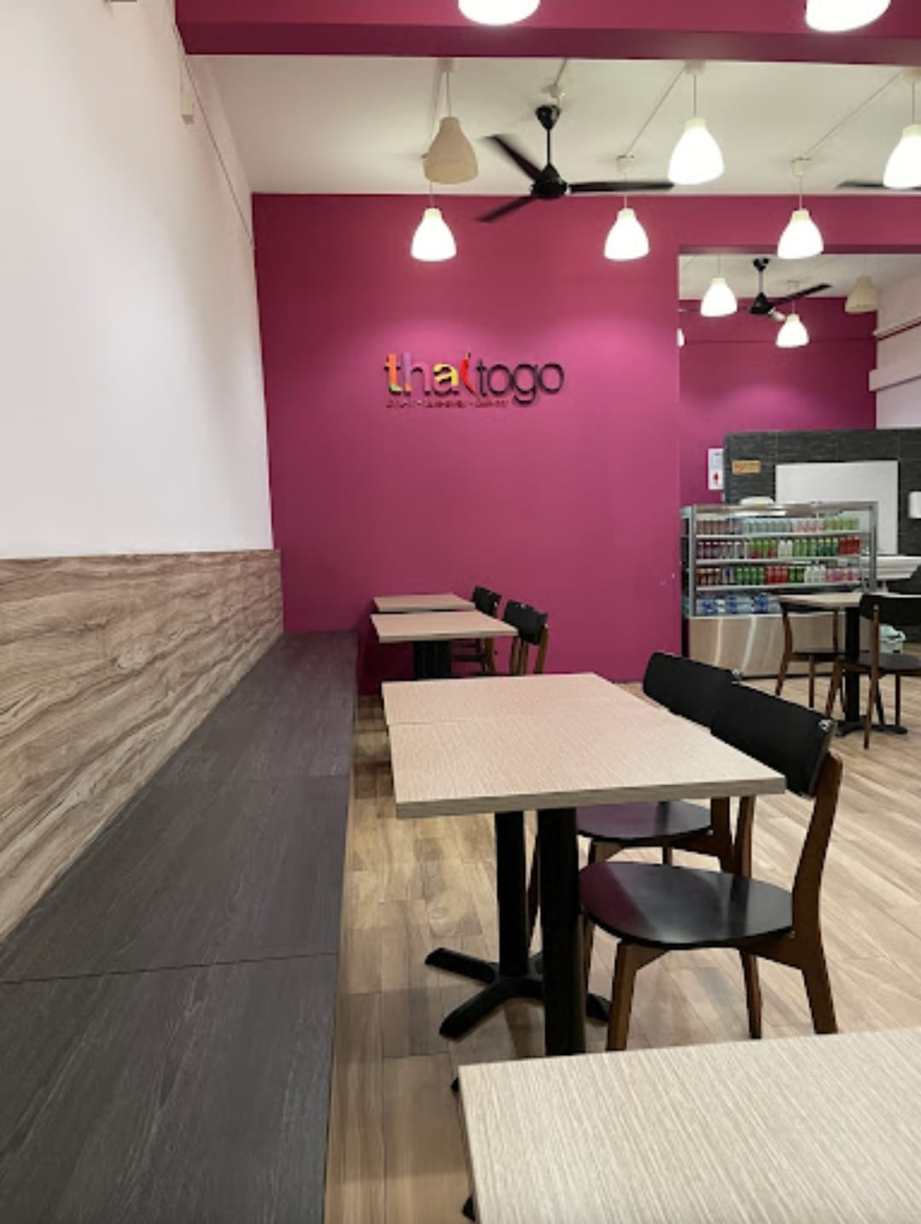
Company Background

Slide 3
Company Background
Thai To Go is a halal Thai restaurant near Eunos MRT
Offering
Order & Pickup
Island wide delivery
Dining In
Mini catering for min 10 pax (No license to do full catering)
Operates for more than 10 years

Slide 4
Core Services & Persona
#1 - In-Restaurant Dines
Attracting local residents and office workers.
#2 - Online Delivery
Partnered with Food Panda.
#3 - In-Restaurant Catering
Hosting events for 20-40 pax.

Slide 5
Unique Value Proposition
Halal certified Thai restaurant near Eunos MRT.
Fusion menu of Thai, Malay, and Western cuisine.
Affordable pricing compared to competitors.
Flexible menu and catering options.

Slide 6
Problem Statement
Business has declined since COVID-19 due to increased WFH practices. The goal is to increase orders, particularly deliveries and catering, and introduce special offers to attract customers.

Slide 7
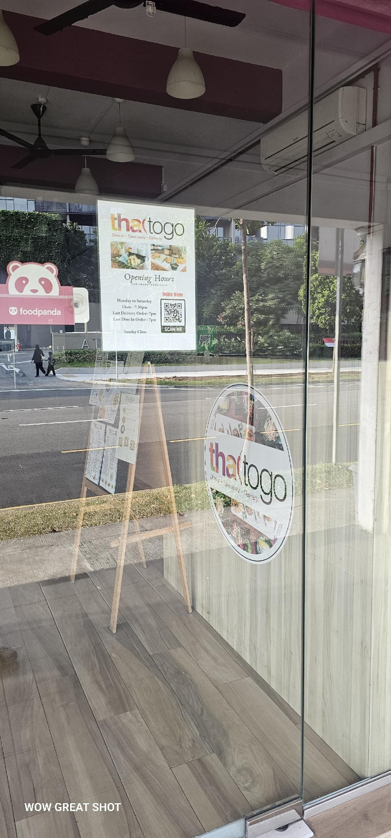
Marketing Plan

Slide 8
Executive Summary
Business Objective: To increase online orders for Thai To Go by 10% within the next 6 months.
Target Market: Busy young professionals who crave delicious and authentic Thai food but are short on time to cook at home.
Market Need: Thai To Go offers a convenient and affordable way to enjoy high-quality Thai food through online ordering and delivery, with a variety of options to suit different dietary needs and preferences.

Slide 9
Executive Summary
Product Overview:
Here's how Thai To Go can address Jane Lui's needs:
Offer a variety of food options with clear calorie information or labeling.
Run promotions and discounts to attract new customers like Jane Lui.
Allow customers to customize a variety of foods
Market Strategy:
Drive Online Orders:
Awareness Stage: Optimize Thai To Go's website and app for a user-friendly online ordering experience.
Considering Stage: Increase Social Marketing.
Decision Stage: Search Engine Marketing.

Slide 10

Persona / Ideal Customer
Demographic Information
Name | Jane Lui
Age | 32
Occupation | Marketing Manager at a Tech Startup
Education Level | Bachelor's Degree in Business Administration
Location | Central Singapore
Single or Married? Any kids? | Married, no children
Income Level | $80,000 SGD per year
Notes | Busy professional with long work hours. Appreciates flavorful food options. Enjoys trying new cuisines but prioritizes convenience. Orders food delivery at least 2-3 times a week. Values quality ingredients and authentic Thai flavors. Seeks out restaurants with positive online reviews and loyalty programs. Prefers contactless delivery options.

Slide 11
Persona / Ideal Customer
Psychographic Information
Life stage | Young Professional (25-34 years old)
Pain Points | Short on time to cook meals at home, tired of unhealthy fast food options, wants variety in their diet.
Motivations | Desire to eat flavorful food, craving authentic Thai cuisine, seeks convenient meal options.
Challenges | Finding food takeout options that are affordable, limited time to research new restaurants, difficulty deciding what to order from a large menu.
Core Values & Beliefs | Values convenience eating, appreciates fresh, high-quality ingredients, enjoys trying new and exciting flavors.

Slide 12
Persona / Ideal Customer
Service Needs & Preferences
Online Behaviour | Researches restaurants online before placing an order Reads online reviews Uses food delivery apps Might be influenced by social media marketing (e.g., Instagrammable dishes, promotions)
Preferred Communication Channels | Mobile app notifications Email marketing Social media platforms (e.g., Facebook, Instagram)
Service Expectations | High-quality, fresh ingredients Authentic Thai flavors Variety of menu options, including vegetarian/vegan options Accurate order fulfillment Friendly customer service
Price Sensitivity | Willing to pay a slight premium for high-quality food Value for money is important Appreciates loyalty programs and special promotions

Slide 13
Persona / Ideal Customer
Decision Making Process
Information Sources | Online reviews (Google, food delivery apps) Social media platforms (Instagram, Facebook) showcasing photos and reviews Recommendations from friends and colleagues
Influencers | Food bloggers reviewing Thai cuisine Social media personalities recommending Thai To Go Positive online reviews from satisfied customers
Barriers to entry | Limited delivery radius excluding potential customers Lack of vegetarian or vegan options on the menu Unfamiliarity with Thai flavors
Decision Triggers | Craving delicious and flavorful Thai food Short on time to cook at home Special promotions or discounts offered by Thai To Go Positive online reviews highlighting taste and convenience

Slide 14
SWOT Analysis of My Company
Strengths:
Convenience: Focus on online ordering and delivery caters to busy lifestyles.
Freshness and Quality: Highlighting fresh ingredients and authentic flavors can attract health-conscious customers.
Long Standing Business: Offering a variety of Thai dishes, including vegetarian/vegan options, broadens your customer base for more than 10 years
Affordability: Competitive pricing positions your business well, especially if you target budget-conscious customers.
Technology: Utilizing a user-friendly app or website streamlines the ordering process.
Weaknesses:
Brand Awareness: A new Thai To Go business might struggle with brand recognition compared to established competitors.
Social media: Limited engagement
Marketing Budget: Limited marketing budget might make it challenging to reach your target audience effectively.
Website: Not attractive

Slide 15
SWOT Analysis of My Company
Opportunities:
Unique Demand: Customize dishes Thai flavour
Online Marketing: Utilizing social media platforms like Instagram for food photography and promotions can attract new customers.
Loyalty Programs: Implementing loyalty programs encourages repeat business and customer retention.
Threats:
Competition: The Thai food market might be saturated with competitors, making it difficult to stand out.
Rising Food Costs: Fluctuations in ingredient prices can affect your profit margins.
Delivery Service Fees: Delivery service fees can inflate overall costs for customers, potentially impacting sales.
Negative Online Reviews: A single bad customer experience reflected in an online review can damage your reputation.
Food Safety Concerns: Maintaining high food safety standards is crucial to avoid negative publicity.

Slide 16
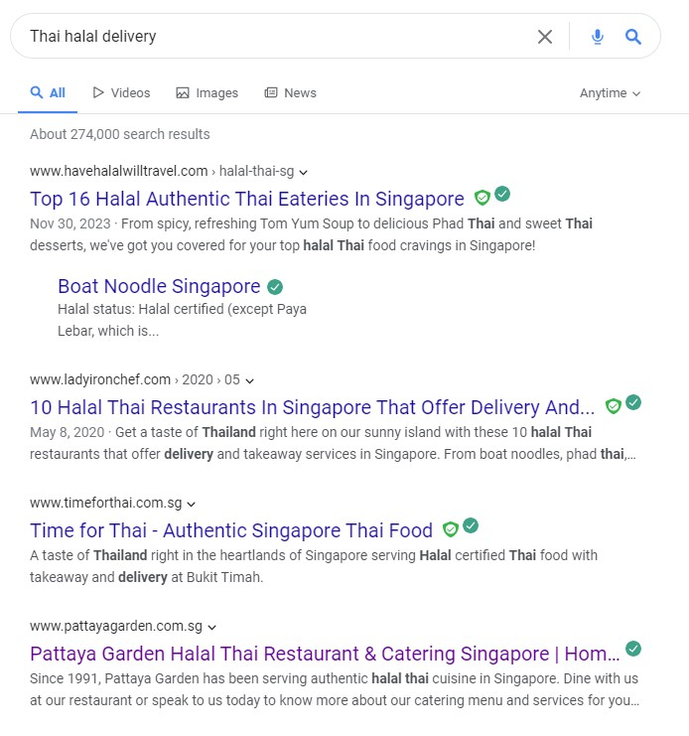

Competitive Analysis - Website
Google Keyword search use “Thai Halal Delivery”
https://www.timeforthai.com.sg/
https://www.pattayagarden.com.sg/

Slide 17
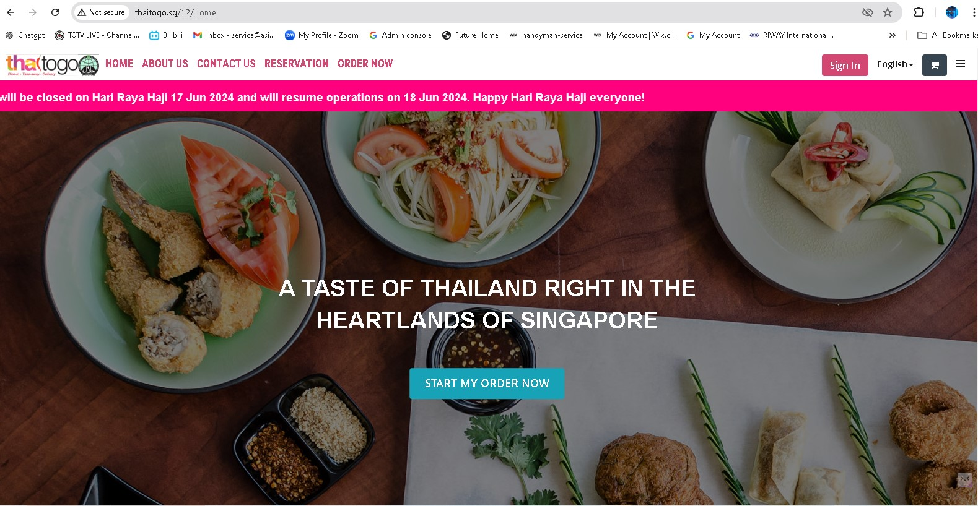
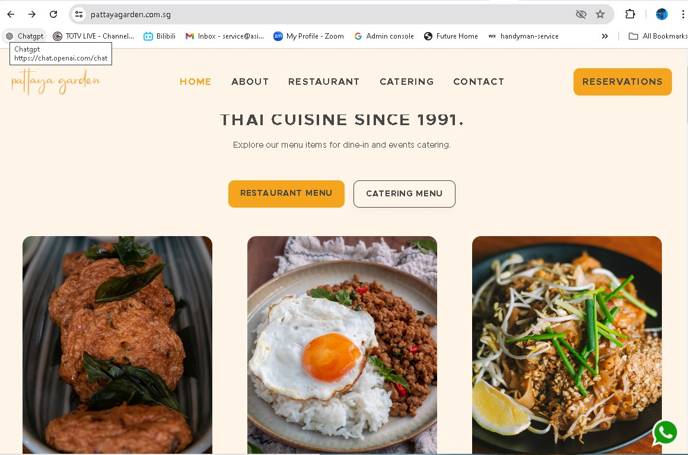
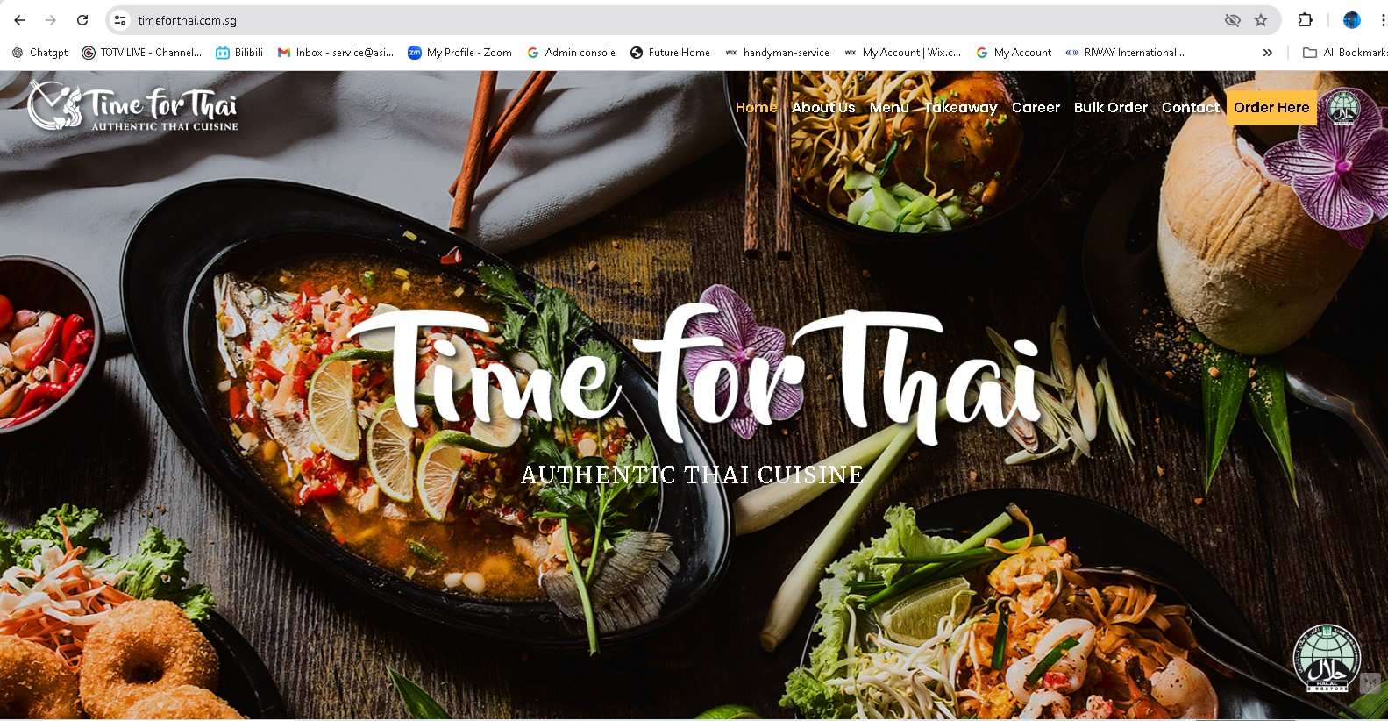
Competitive Analysis - Website
http://www.thaitogo.sg
https://www.pattayagarden.com.sg/
https://www.timeforthai.com.sg/

Slide 18
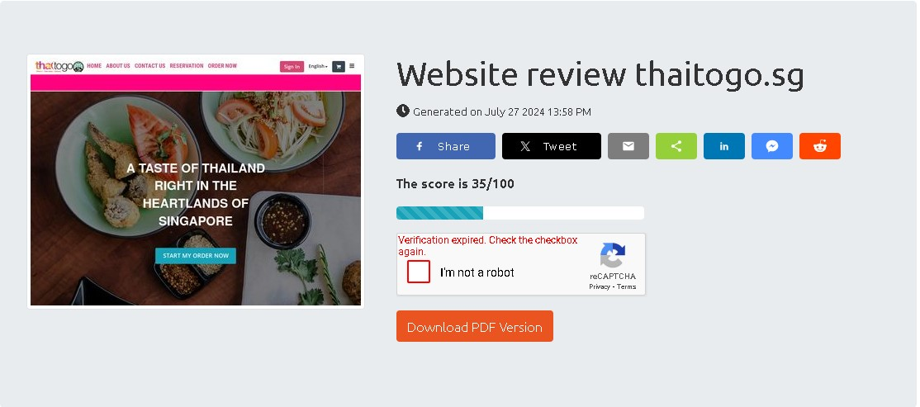
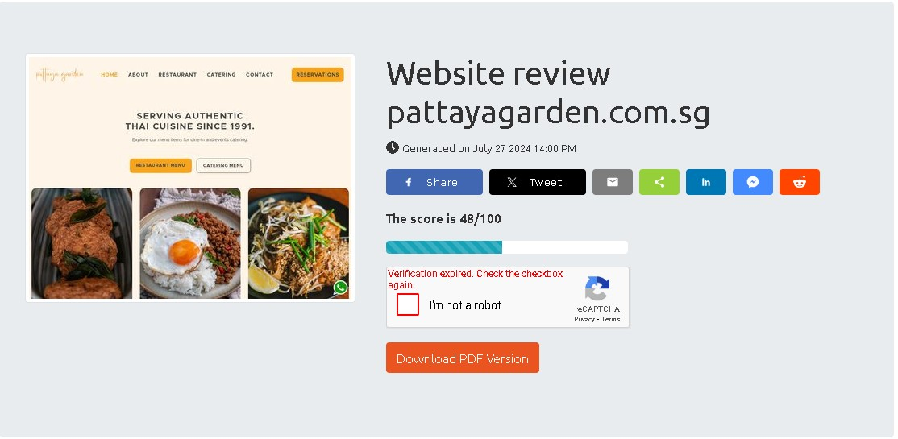
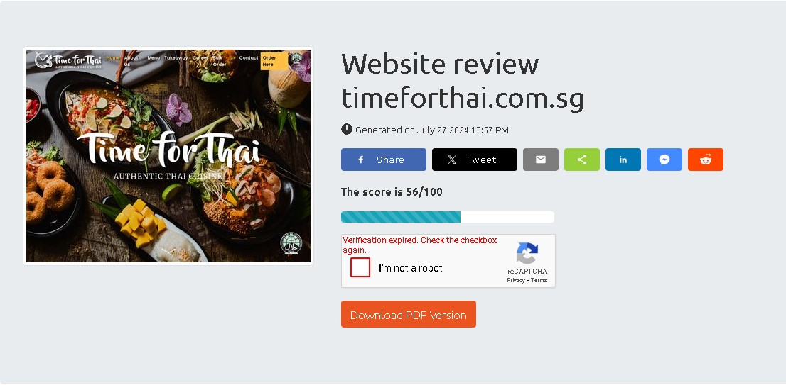
Competitive Analysis - Website Review Score

Slide 19
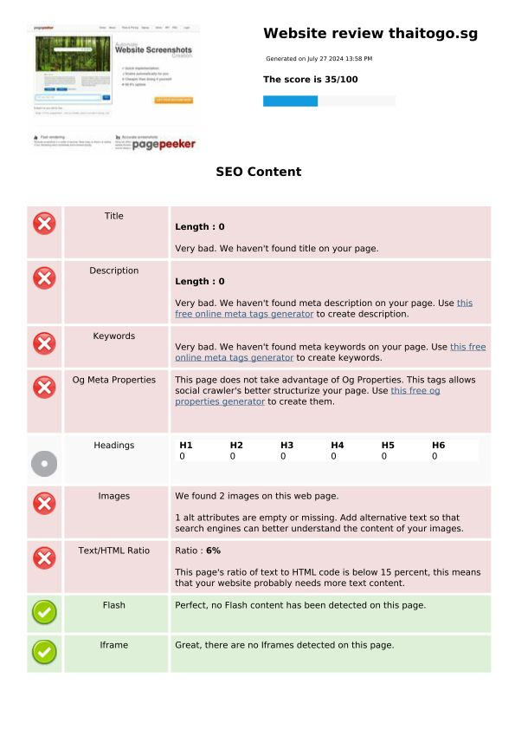
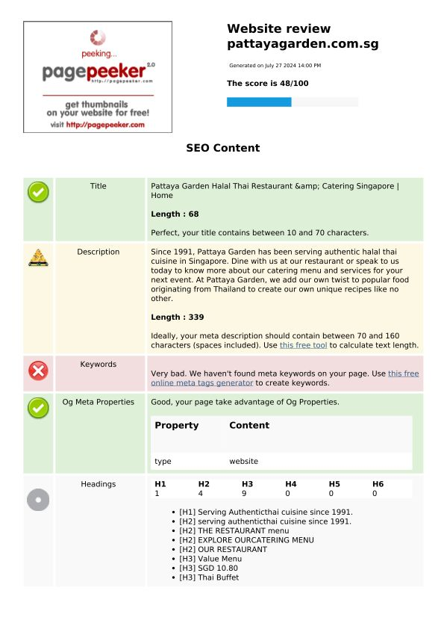
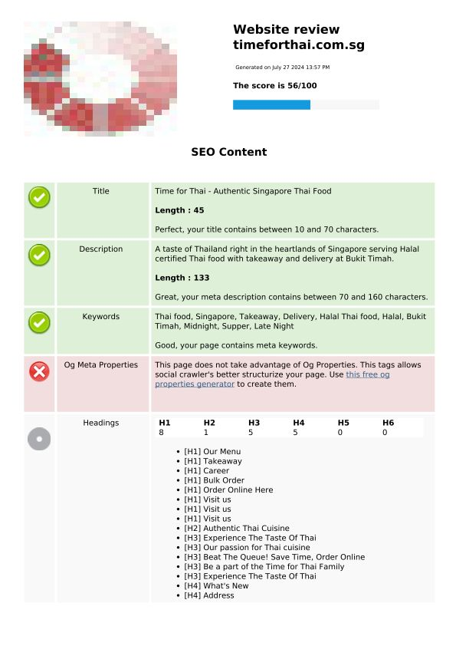
Competitive Analysis - Website SEO

Slide 20
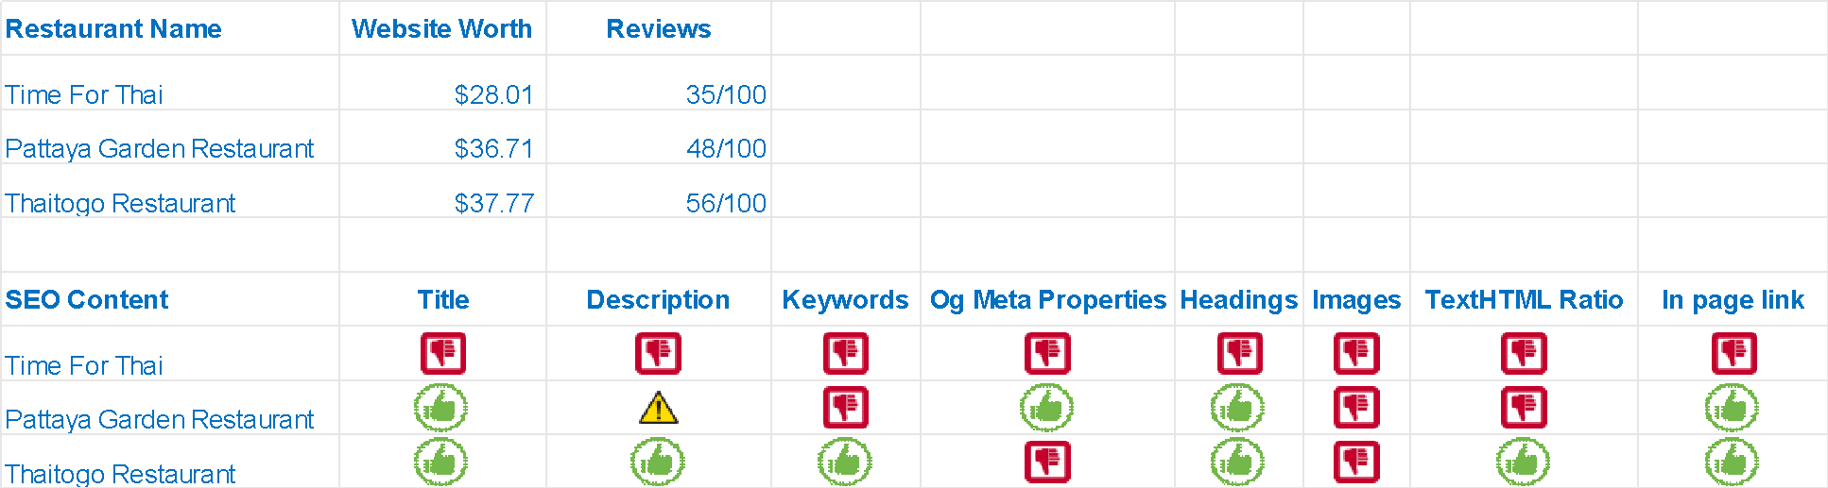
Competitive Analysis - Website SEO

Slide 21
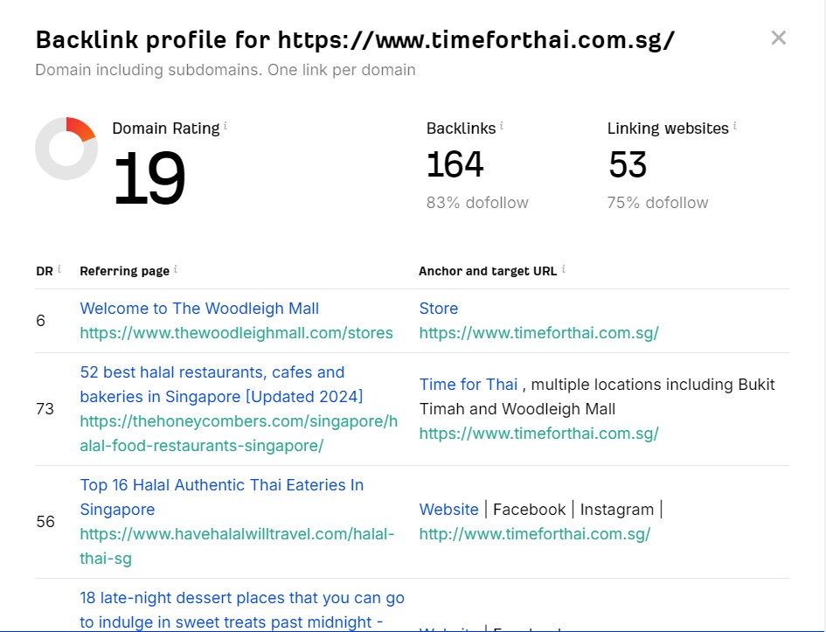
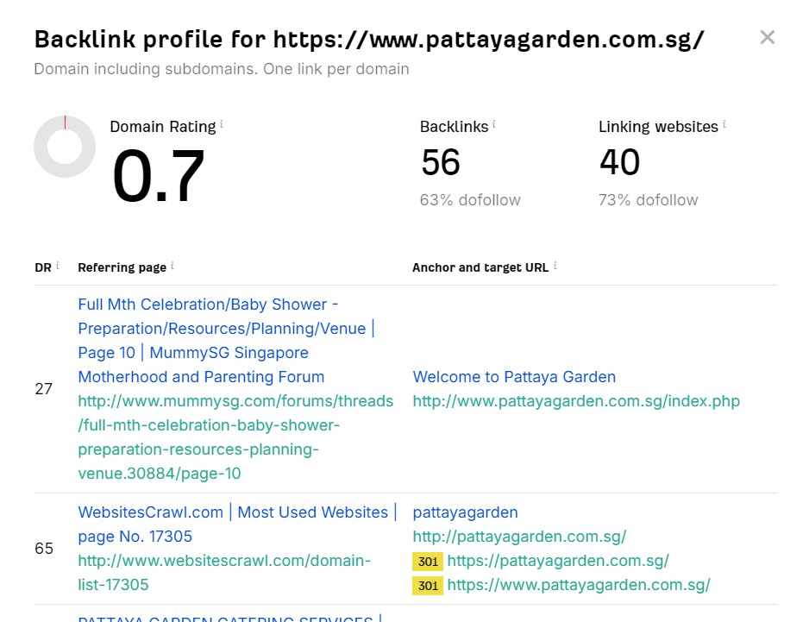

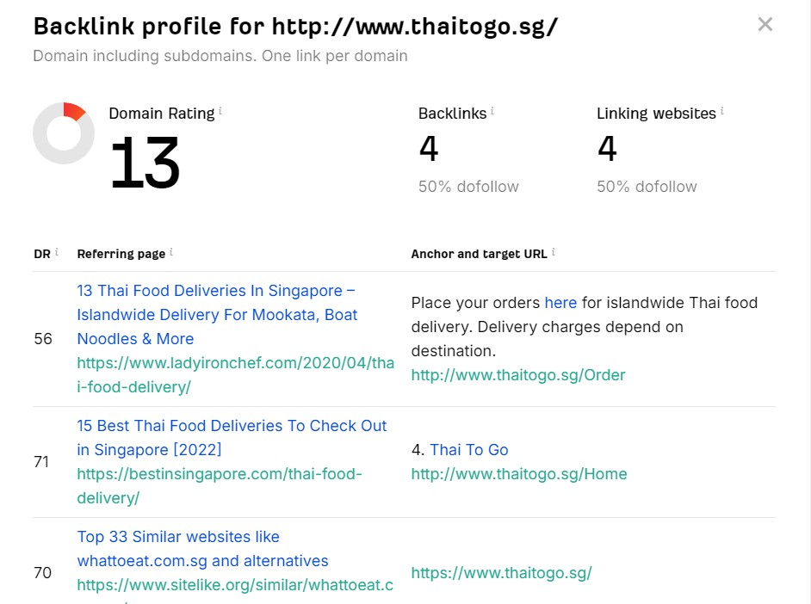
Competitive Analysis - Website Backlink
Use of ahrefs to see Backlink Checker
https://ahrefs.com/backlink-checker

Slide 22
Competitive Analysis - Website Backlink
Comparison Table 1
Restaurant Name | Domain Rating | Backlinks | Linking Websites
Thai To Go | 13 | 4 | 4
Pattaya Garden Restaurant | 0.7 | 56 | 40
Time For Thai | 19 | 164 | 53
Setup and improve backlink
A backlink, also known as an inbound link or incoming link, is a hyperlink from one website to another. Backlinks are important for several reasons:
SEO (Search Engine Optimization): Backlinks are a key factor in how search engines rank websites. High-quality backlinks from authoritative websites can improve a site's search engine ranking.
Referral Traffic: Backlinks can drive traffic to your website from other sites. If a popular website links to your site, their visitors might click the link and visit your site.
Credibility and Authority: Backlinks from reputable sites can enhance the credibility and authority of your website. They act as endorsements from other websites.
Indexing: Search engines use backlinks to discover new web pages. If your site is linked to from another site, search engines can find and index your site more easily.
Brand Awareness: Backlinks can help increase your brand's visibility and recognition. When your site is linked to from multiple places, it can help build your brand's presence online.
Overall, backlinks are a critical component of a successful digital marketing and SEO strategy.

Slide 23
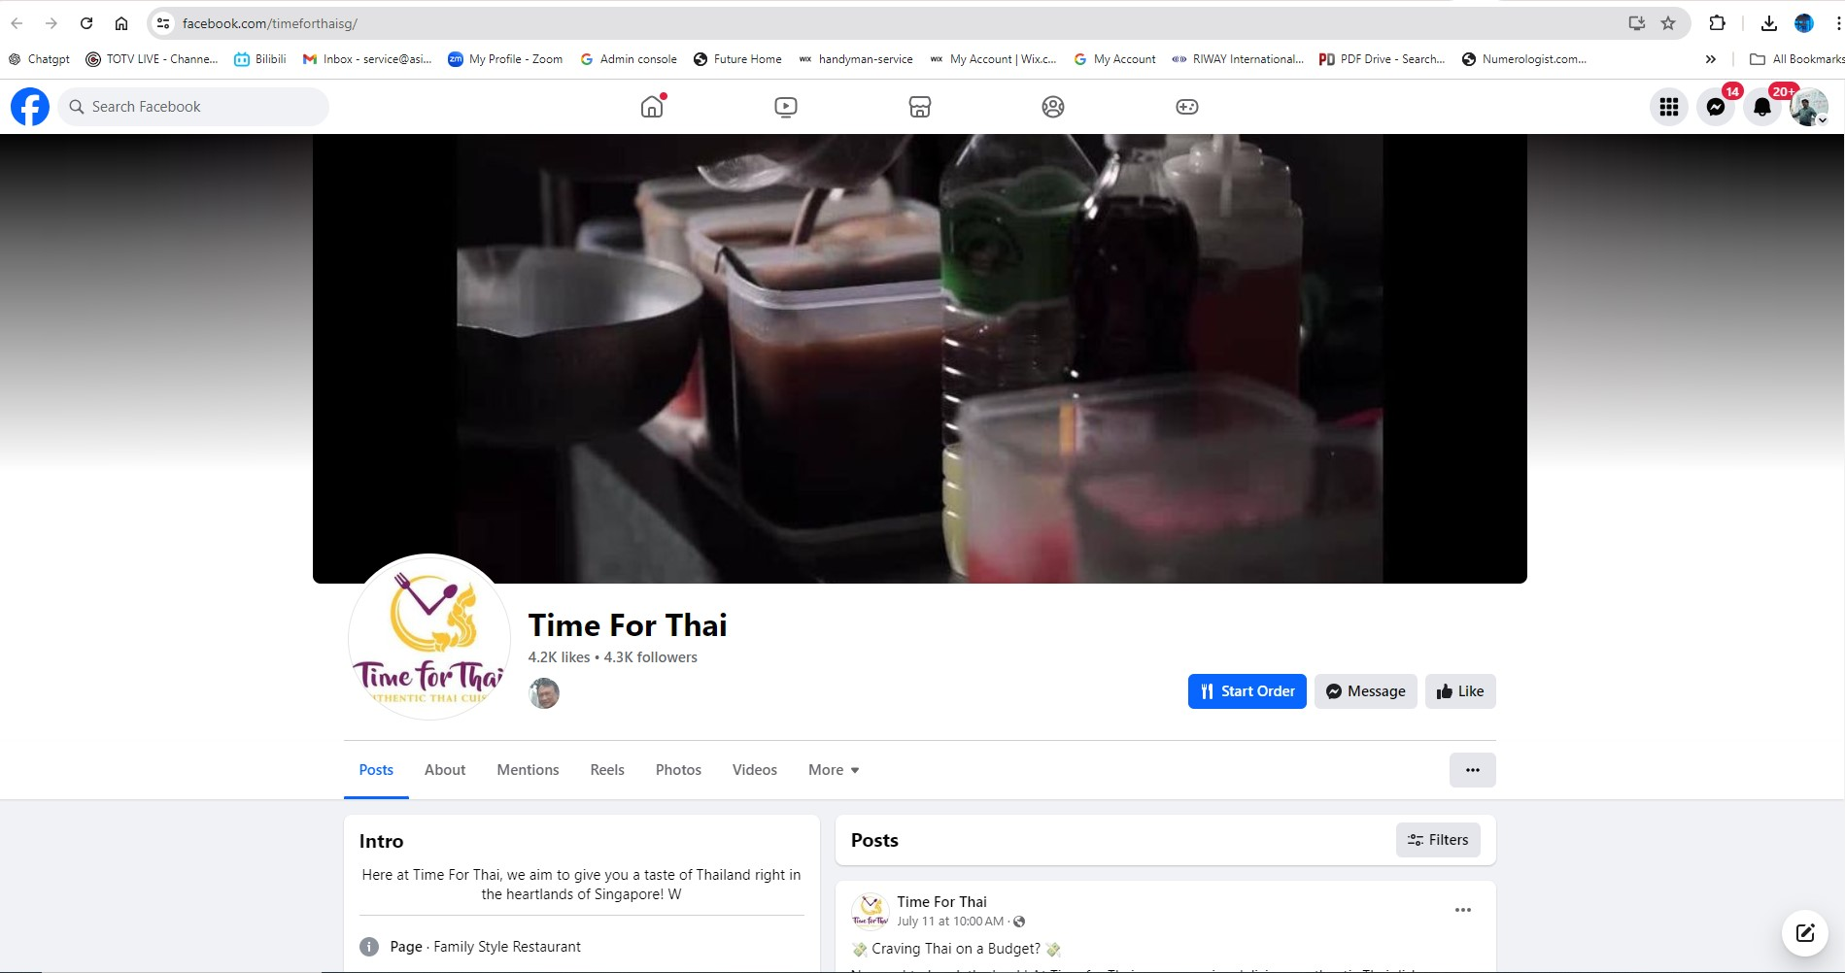
Competitive Analysis - Facebook

Slide 24
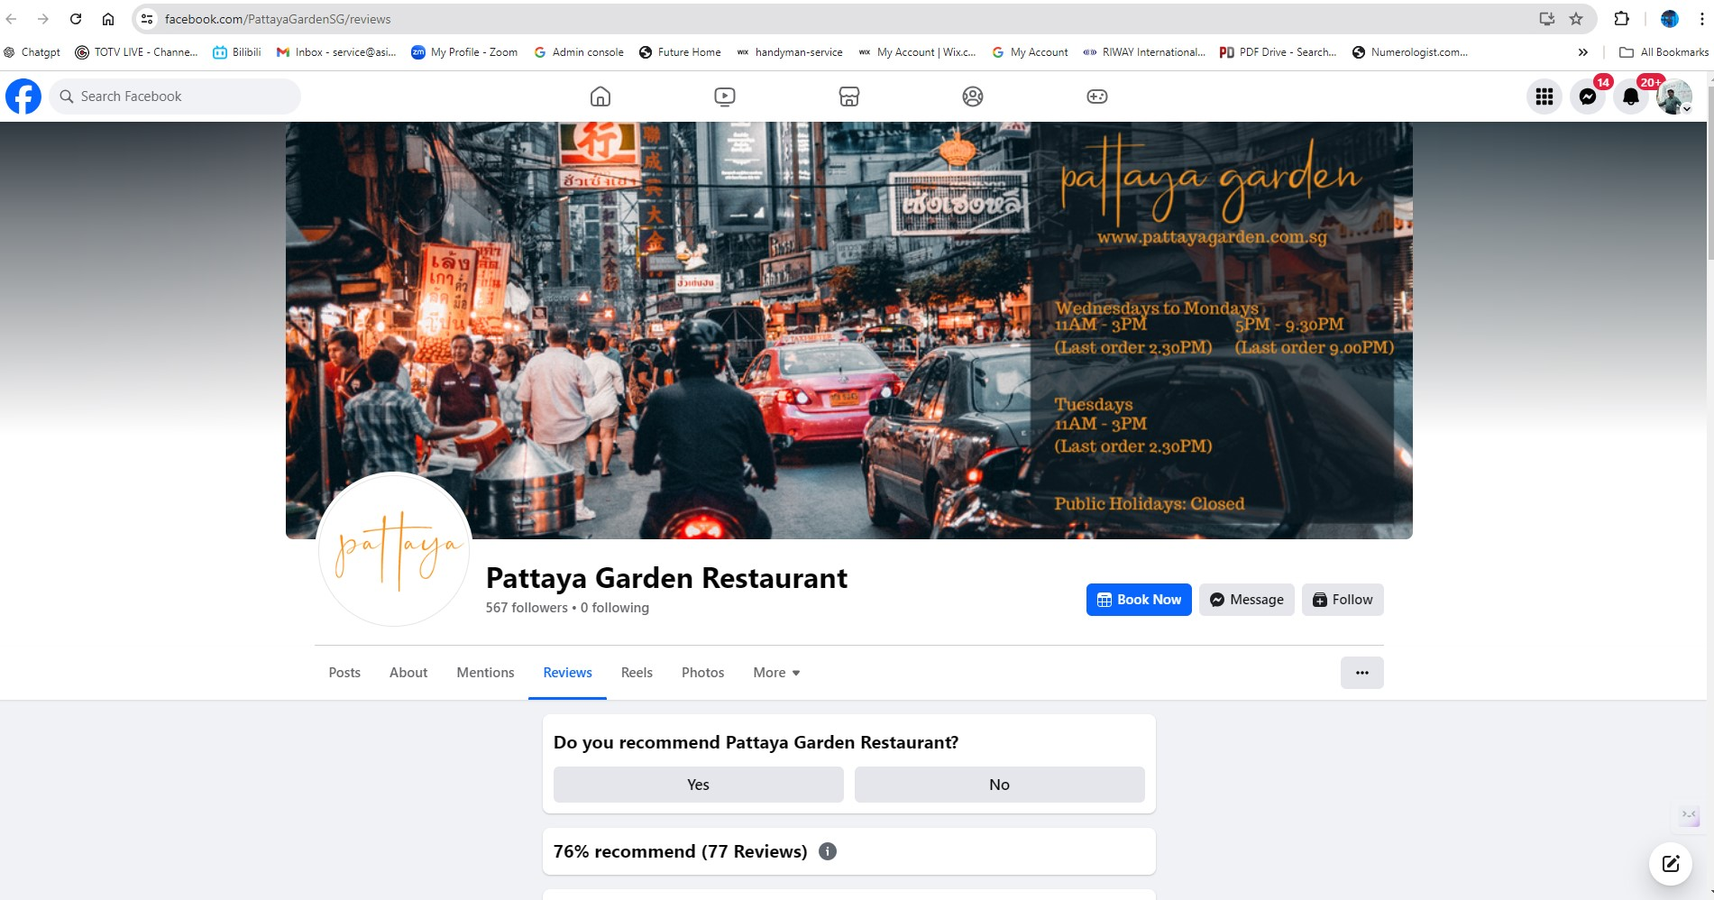
Competitive Analysis - Facebook

Slide 25
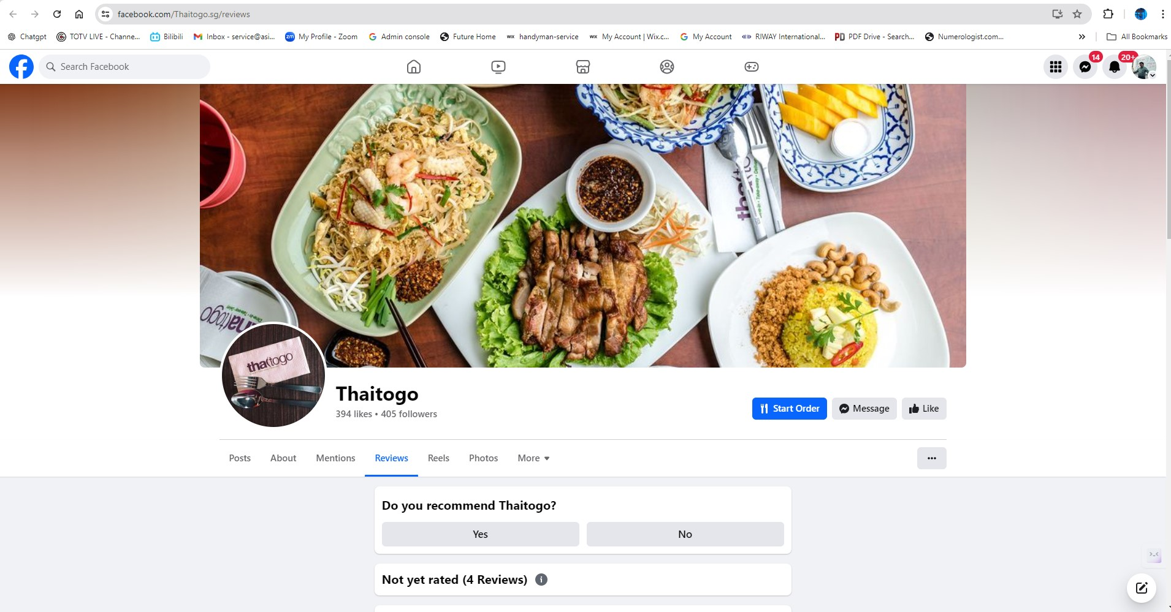
Competitive Analysis - Facebook

Slide 26
Competitive Analysis - Facebook
Comparison Table 2
Restaurant Name | Followers | Following | Reviews | Recommend
Thaitogo | 394 | 405 | 4 | Not Yet Rated
Pattaya Garden Restaurant | 567 | 0 | 77 | 76%
Time For Thai | 4200 | 4300 | No Show | No Show
Followers
Definition: People who have chosen to see your posts in their News Feed. When someone follows your profile or Page, they can see your updates.
Significance: The number of followers is a metric that indicates the reach and popularity of your profile or Page. More followers usually mean a broader audience for your content.
Following
Definition: The accounts that you have chosen to follow. This means you will see their updates in your News Feed.
Significance: Following others allows you to stay updated with their content. For businesses or influencers, following relevant accounts can be a way to engage with the community and stay informed about industry trends.
Reviews
Definition: Feedback left by users on your Facebook Page. This typically involves a star rating (1-5 stars) and a written comment.
Significance: Reviews provide social proof and can influence potential customers' perceptions and decisions. Positive reviews can enhance credibility and attract more visitors, while negative reviews can provide valuable feedback for improvement.
Recommend Score (Recommendation Score)
Definition: A metric that represents the percentage of users who recommend your Page. Users can recommend (or not recommend) your business on Facebook.
Significance: The recommendation score is an important indicator of customer satisfaction and trust. A high recommendation score suggests that a significant portion of your audience values and endorses your business, which can attract more followers and customers.

Slide 27
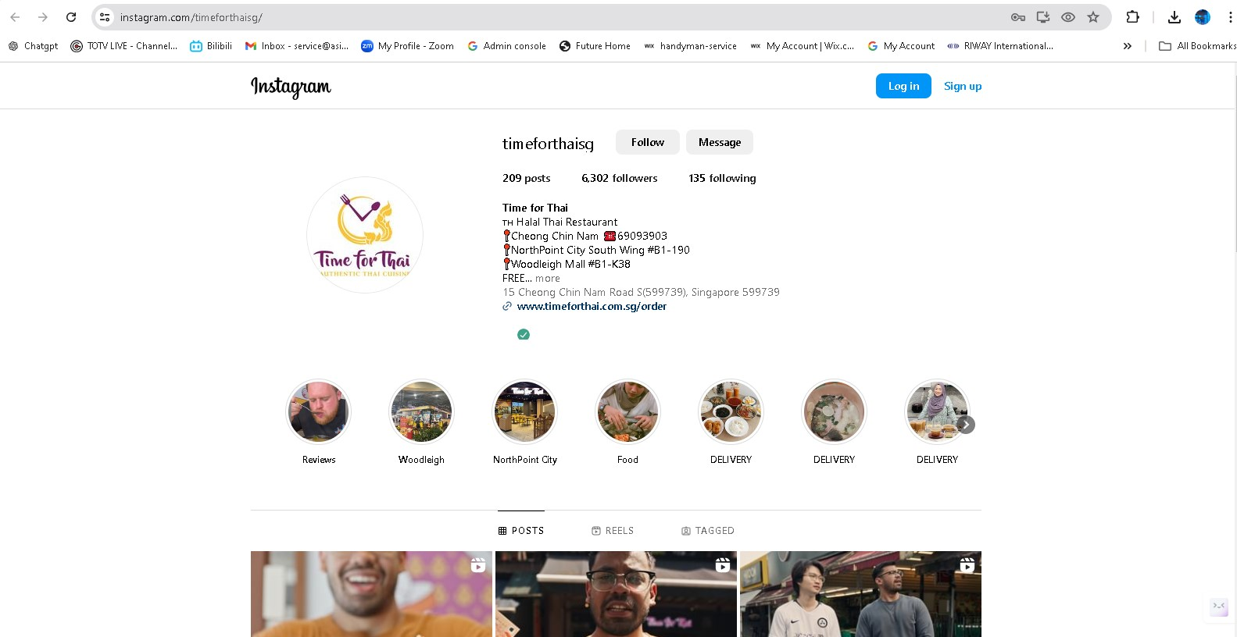
Competitive Analysis - Instagram

Slide 28
Competitive Analysis - Instagram
Comparison Table 3
Restaurant Name | Posts | Followers | Following
Thaitogo | No Instagram | No Instagram | No Instagram
Pattaya Garden Restaurant | No Instagram | No Instagram | No Instagram
Time For Thai | 207 | 6303 | 135
Instagram is a powerful platform for marketing due to its visual nature and high user engagement. Here’s a step-by-step guide on how to use Instagram to promote your marketing efforts:
Step 1: Set Up Your Profile
Create a Business Account: Switch to an Instagram Business account to access features like analytics and advertising.
Optimize Your Bio: Write a compelling bio that clearly states who you are and what you offer. Include a link to your website or a specific landing page.
Profile Picture: Use a recognizable logo or image that represents your brand.
Step 2: Develop a Content Strategy
Define Your Goals: Determine what you want to achieve, such as brand awareness, engagement, or sales.
Identify Your Target Audience: Understand who your ideal followers are in terms of demographics, interests, and behavior.
Plan Your Content: Create a content calendar to schedule regular posts. Include a mix of photos, videos, stories, and IGTV content.

Slide 29
Competitive Analysis - Instagram
Step 3: Create High-Quality Content
Visual Appeal: Use high-resolution images and videos. Make sure your content is visually consistent and aligned with your brand aesthetics.
Engaging Captions: Write engaging captions that encourage interaction. Use calls-to-action (CTAs) to prompt followers to like, comment, or share.
Hashtags: Use relevant hashtags to increase the discoverability of your posts. Mix popular hashtags with niche ones specific to your industry.
Step 4: Utilize Instagram Stories and Reels
Stories: Post behind-the-scenes content, product launches, or quick updates. Use interactive features like polls, questions, and countdowns to engage your audience.
Reels: Create short, engaging videos that showcase your products, provide tips, or entertain your audience.
Step 5: Engage with Your Audience
Respond to Comments and Messages: Engage with your followers by replying to their comments and direct messages.
User-Generated Content: Encourage followers to create content featuring your products and share it on your profile. This builds community and trust.
Step 6: Collaborate with Influencers
Identify Influencers: Find influencers who align with your brand and have an engaged following.
Partnerships: Collaborate on content, host giveaways, or have influencers take over your account for a day to reach a wider audience.

Slide 30
Competitive Analysis - Instagram
Step 7: Use Instagram Ads
Ad Types: Choose from photo ads, video ads, carousel ads, or story ads based on your campaign goals.
Targeting: Use Instagram’s targeting options to reach your ideal audience based on demographics, interests, behaviors, and more.
Budget and Bidding: Set a budget and bid strategy that aligns with your goals.
Step 8: Monitor and Analyze Performance
Instagram Insights: Use the built-in analytics tool to track the performance of your posts, stories, and ads.
Key Metrics: Focus on metrics like engagement rate, reach, impressions, and follower growth to assess your performance.
Adjust Your Strategy: Use insights to tweak your content strategy, posting times, and ad campaigns for better results.
Step 9: Run Contests and Giveaways
Plan Your Contest: Decide on the type of contest or giveaway, the entry requirements, and the prizes.
Promote It: Use posts, stories, and ads to promote your contest and encourage participation.
Engage: Announce winners and share user-generated content from the contest to keep the excitement going.
Step 10: Integrate with Other Marketing Channels
Cross-Promote: Share your Instagram content on other social media platforms, your website, and email newsletters.
Consistency: Ensure your branding and messaging are consistent across all channels to reinforce your brand identity.

Slide 31
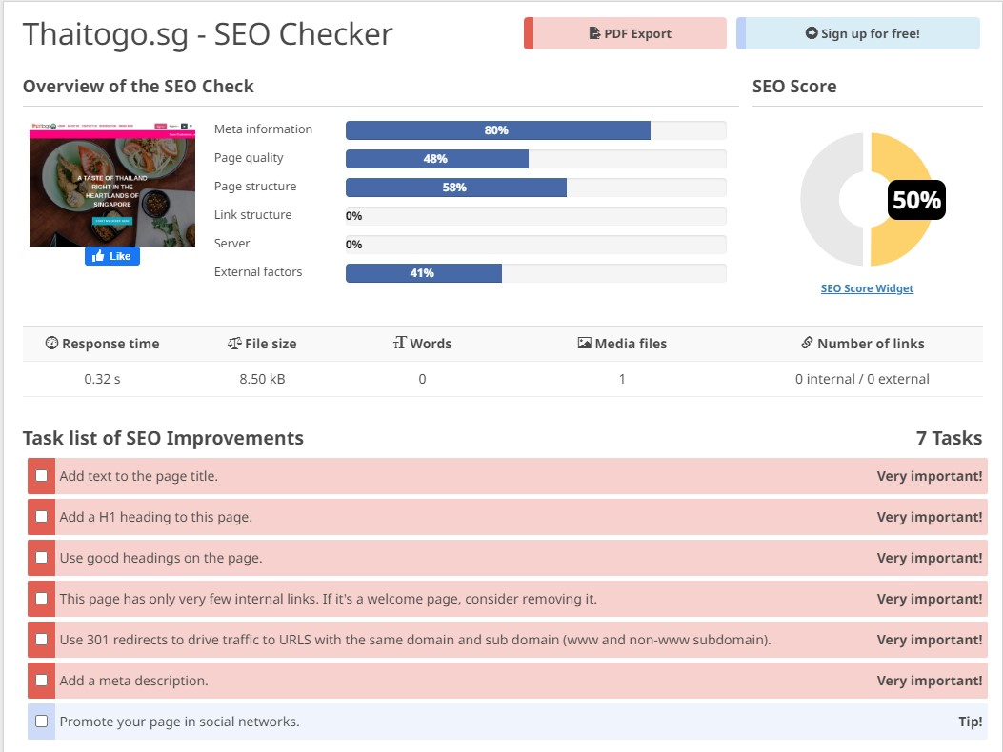
Competitive Analysis – Website SEO
https://freetools.seobility.net/en/seocheck/thaitogo.sg

Slide 32
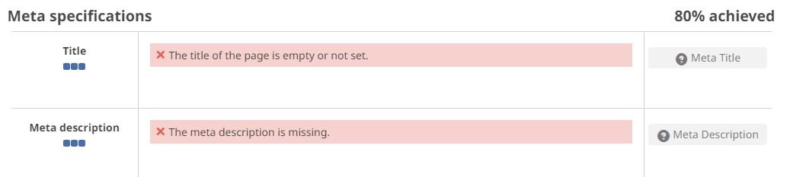
Competitive Analysis – Website SEO

Slide 33
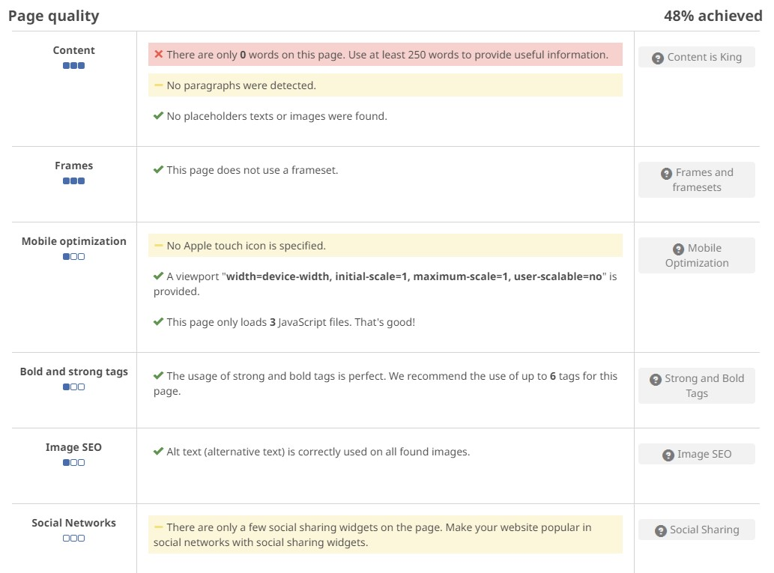
Competitive Analysis – Website SEO

Slide 34
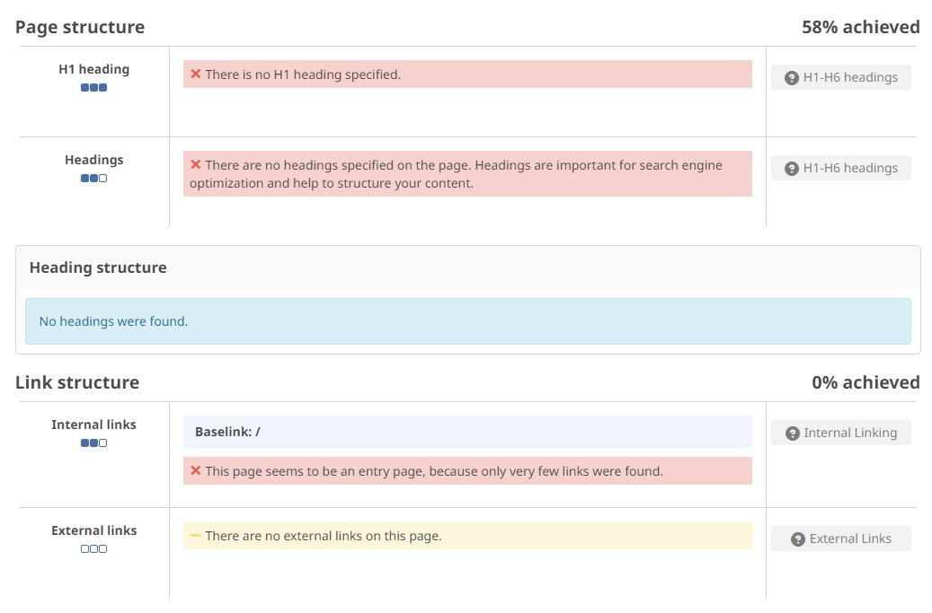
Competitive Analysis – Website SEO

Slide 35
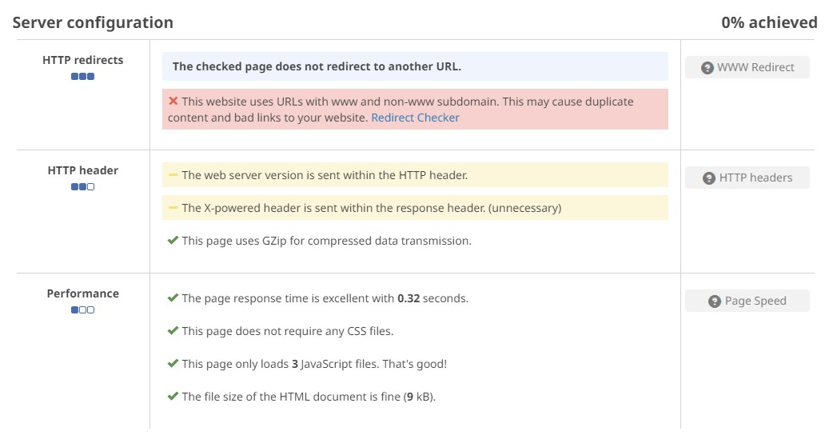
Competitive Analysis – Website SEO

Slide 36
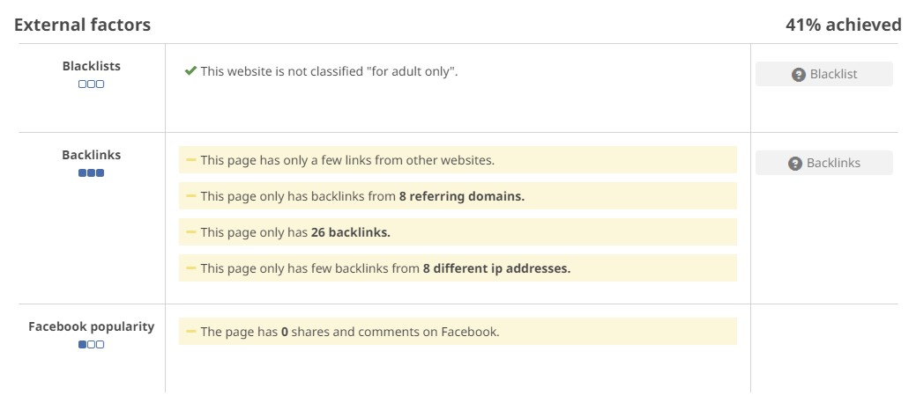
Competitive Analysis – Website SEO

Slide 37
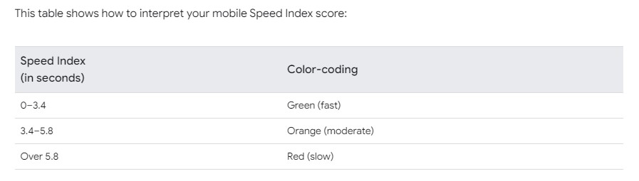
Competitive Analysis – Website Speed
Speed check more than 3.4 seconds not good
Desktop
https://pagespeed.web.dev/analysis/http-www-thaitogo-sg/eiy64yeyrx?form_factor=desktop
Mobilephone
https://pagespeed.web.dev/analysis/http-www-thaitogo-sg/eiy64yeyrx?form_factor=mobile

Slide 38
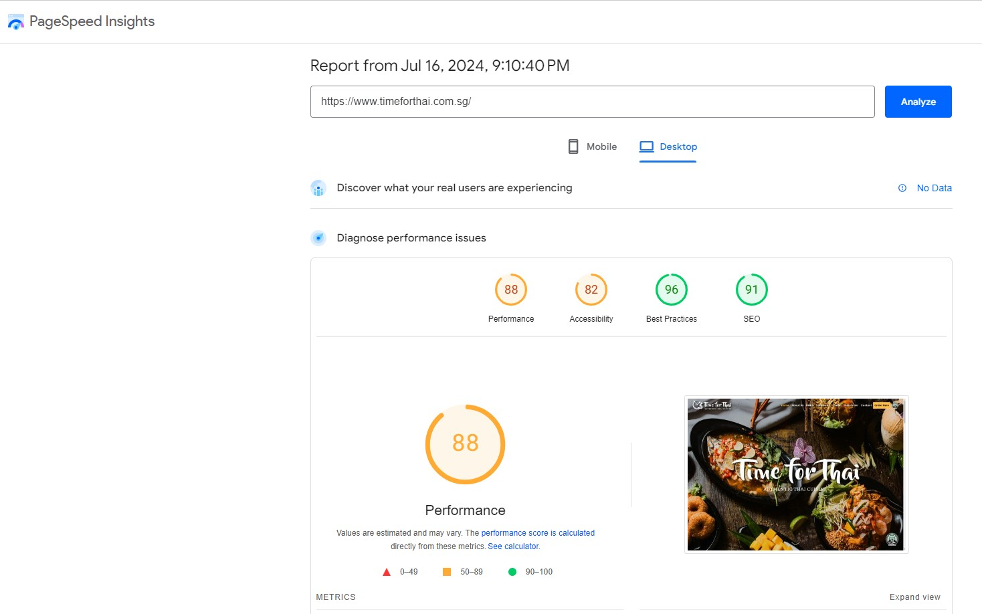
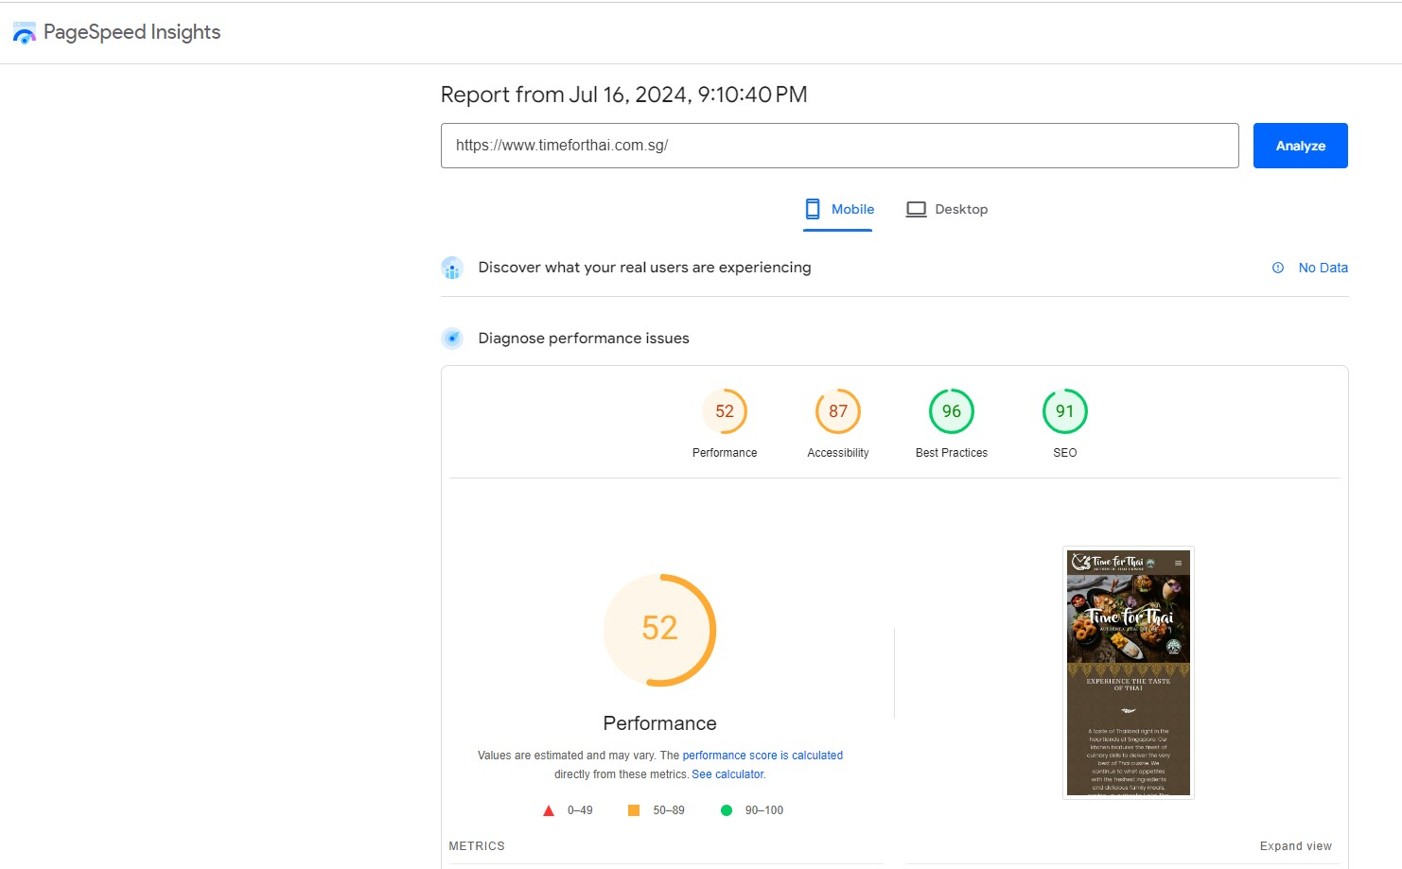

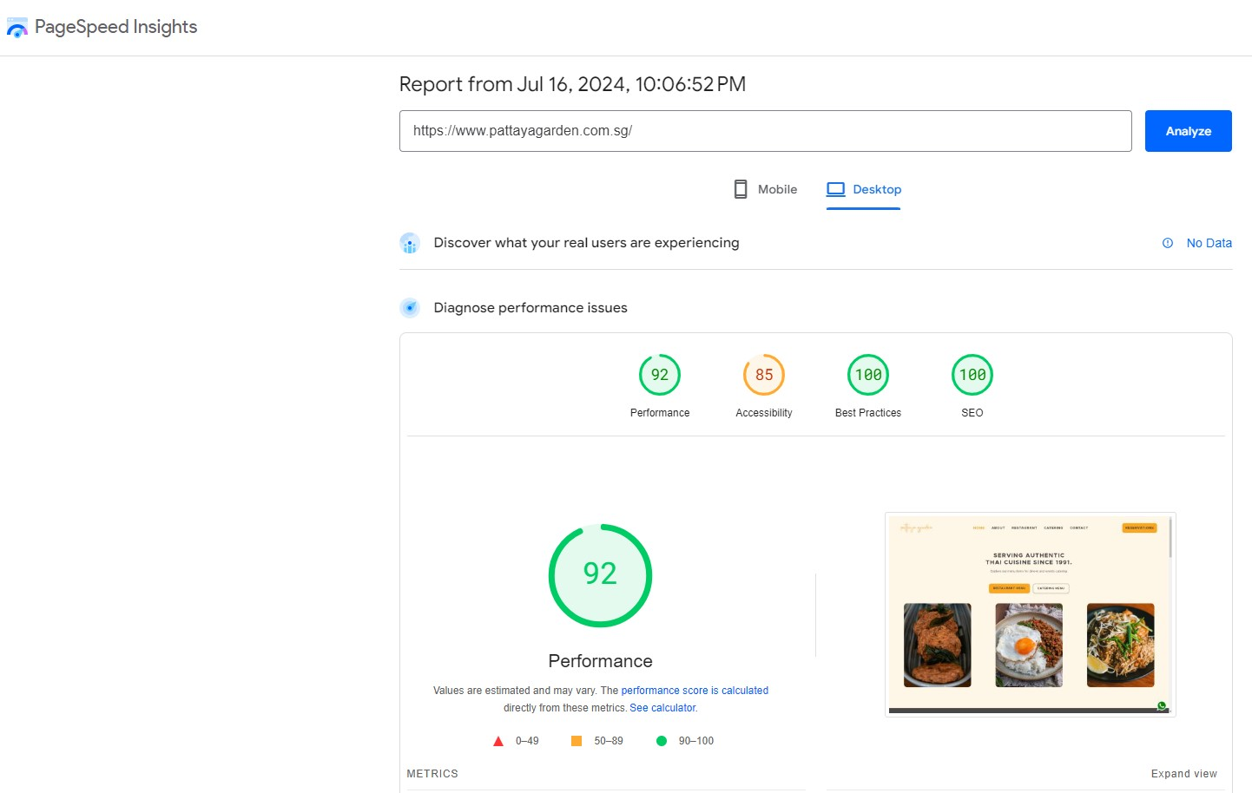
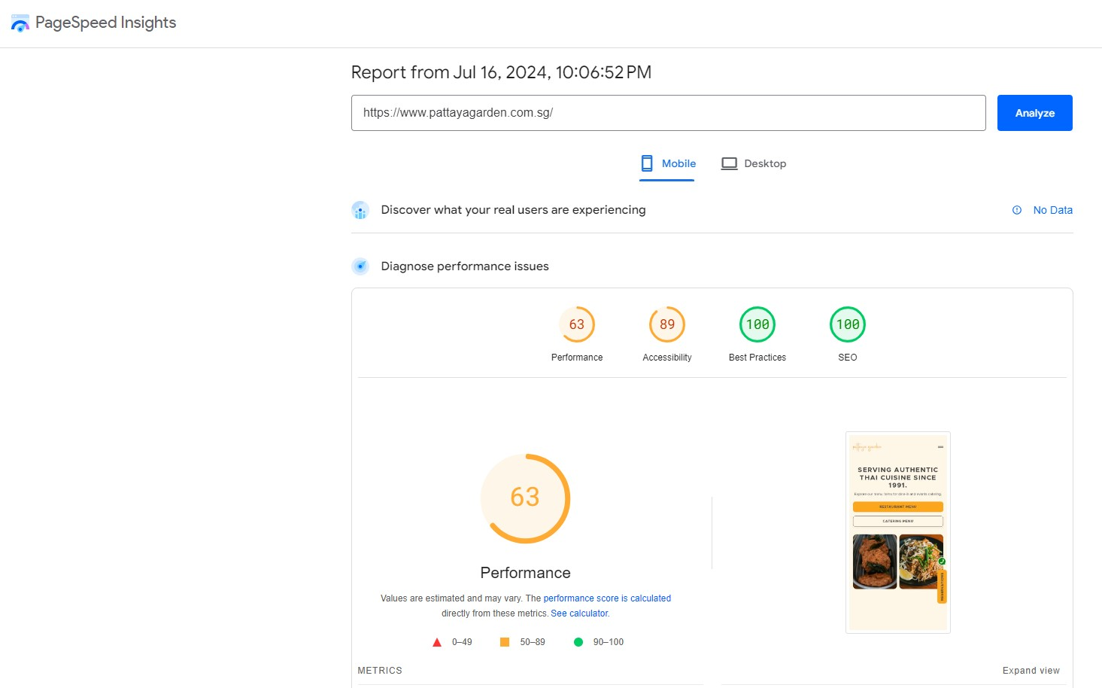
Competitive Analysis - Website

Slide 39
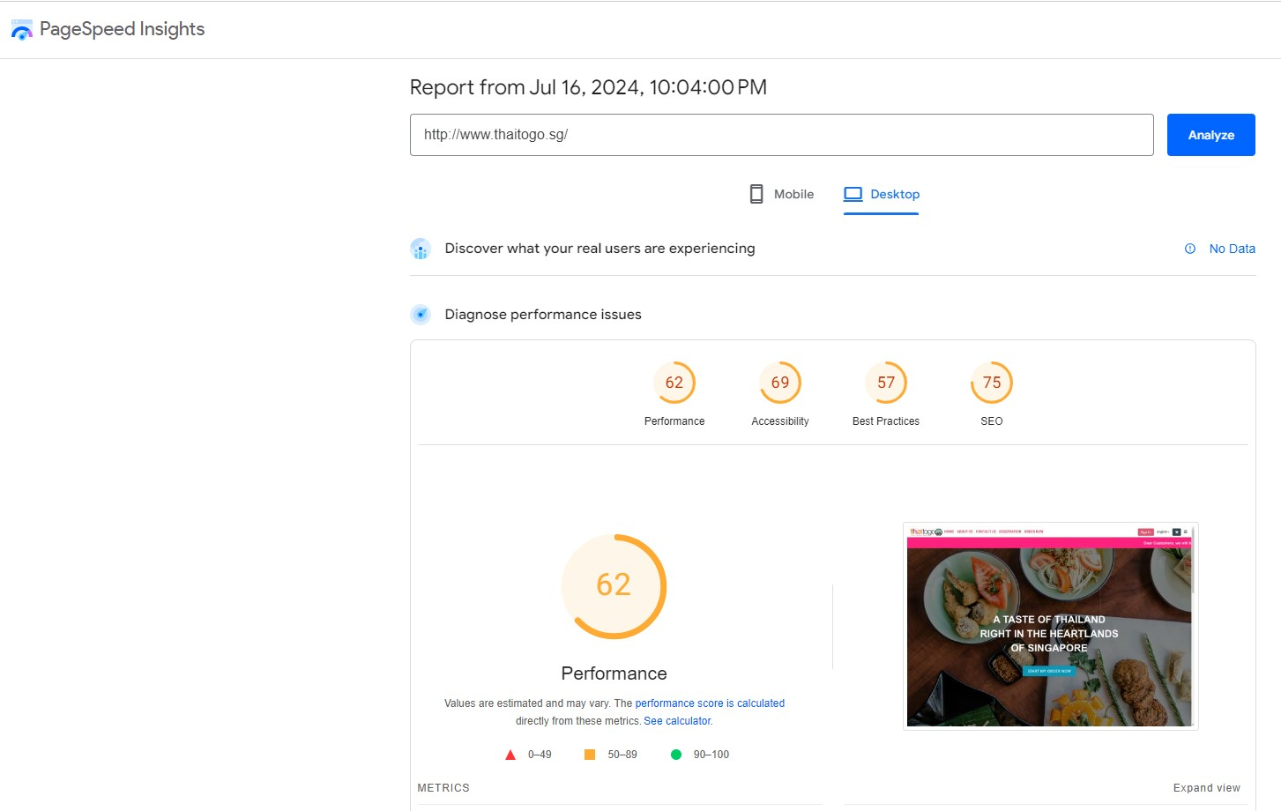
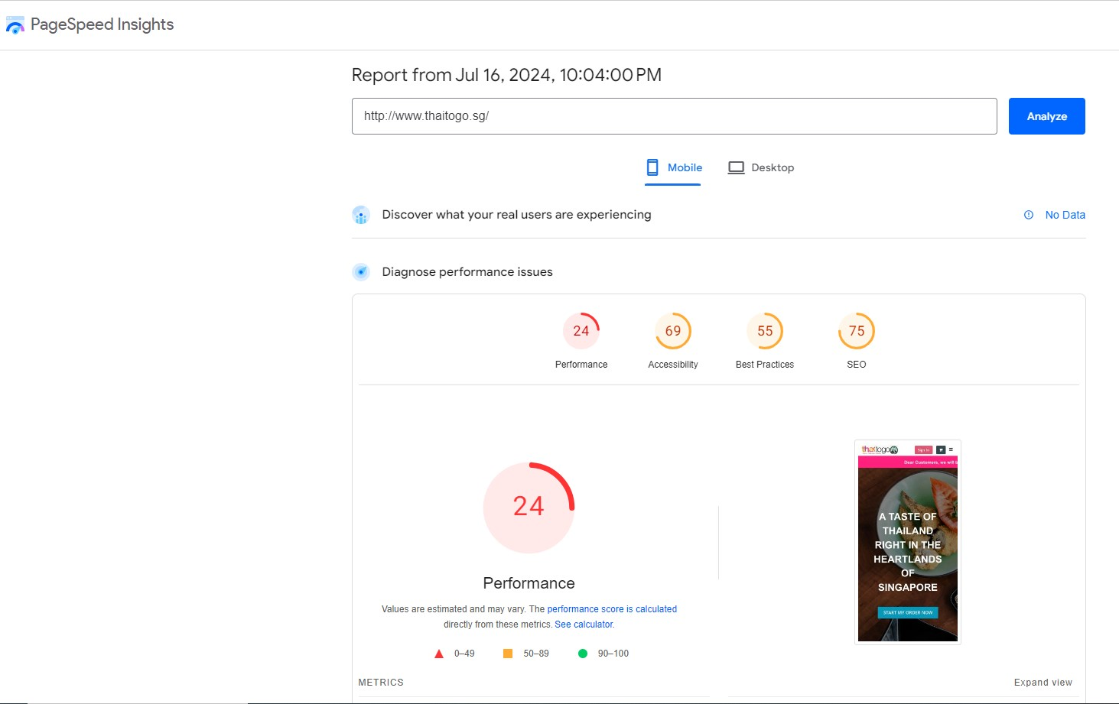
Competitive Analysis - Website

Slide 40
Competitive Analysis - Website
Comparison Table 4
Restaurant Name |  | Performance | Accessibility | Best Practices | SEO | Speed Index
Thaitogo | Desktop | 52 | 69 | 57 | 75 | 2.6 s
 | Mobilephone | 27 | 69 | 55 | 75 | 7.4 s
Pattaya Garden Restaurant | Desktop | 92 | 85 | 100 | 100 | 1 s
 | Mobilephone | 63 | 89 | 100 | 100 | 4.2 s
Time For Thai | Desktop | 95 | 82 | 96 | 91 | 0.9 s
 | Mobilephone | 53 | 87 | 96 | 91 | 2.5 s
 |  |  |  |  | Speed Index Score (s)
 |  |  | 90-100 |  |  | 0-3.4
 |  |  | 50-89 |  |  | 3.4-5.8
 |  |  | 0-49 |  |  | Over 5.8

Slide 41
Competitive Analysis - Optimizing Website
Performance
Definition: Measures how quickly your web pages load and are ready for user interaction.
Key Metrics:
First Contentful Paint (FCP): The time it takes for the first piece of content to appear on the screen.
Largest Contentful Paint (LCP): The time it takes for the largest piece of content to be visible.
Time to Interactive (TTI): The time it takes for the page to become fully interactive.
Total Blocking Time (TBT): The total time during which the main thread is blocked, preventing user interaction.
Cumulative Layout Shift (CLS): Measures the visual stability of the page, i.e., how much the content shifts while loading.

Slide 42
Competitive Analysis - Optimizing Website
Accessibility
Definition: Evaluates how easily users, including those with disabilities, can access and navigate your website.
Key Considerations:
Alt Text for Images: Ensuring images have descriptive text for screen readers.
Contrast Ratios: Ensuring text is readable against background colors.
Keyboard Navigation: Ensuring all functionalities are accessible via keyboard.
Aria Attributes: Using ARIA (Accessible Rich Internet Applications) attributes to enhance accessibility.

Slide 43
Competitive Analysis - Optimizing Website
Best Practices
Definition: Reviews the use of modern web development practices to ensure security and optimal performance.
Key Practices:
HTTPS: Ensuring the site is served over a secure connection.
JavaScript Practices: Avoiding deprecated APIs and minimizing JavaScript errors.
Responsive Design: Ensuring the site works well on various screen sizes and devices.
Minimizing Redirects: Reducing the number of redirects to improve load times.

Slide 44
Competitive Analysis - Optimizing Website
SEO (Search Engine Optimization)
Definition: Evaluates how well your website is optimized for search engines to understand and rank it.
Key Factors:
Meta Tags: Ensuring relevant and descriptive meta titles and descriptions.
Heading Structure: Using a proper heading hierarchy (H1, H2, etc.).
Mobile-Friendliness: Ensuring the site is optimized for mobile devices.
Alt Text: Using descriptive alt text for images.
Structured Data: Implementing schema markup for enhanced search results.

Slide 45
Competitive Analysis - Optimizing Website
Speed Index
Definition: Measures how quickly the content of a page is visibly populated. It reflects the user's perception of load speed.
How It's Calculated: The Speed Index score is calculated based on the visual progression of content being painted on the screen over time. Lower scores indicate better performance.
Impacts:
User Experience: Faster visual load times result in a better user experience.
Bounce Rate: Lower speed index scores can reduce bounce rates as users are less likely to leave a site that loads quickly.
Search Rankings: Speed Index can impact SEO as search engines prioritize fast-loading websites.

Slide 46
Competitive Analysis - Optimizing Website
Tools for Checking Website Performance
Google Lighthouse: Provides detailed reports on performance, accessibility, best practices, and SEO.
Google PageSpeed Insights: Analyzes the content of a web page and provides suggestions to make it faster.
GTmetrix: Offers insights on website speed and recommendations for improvement.
WebPageTest: Provides comprehensive performance testing from multiple locations around the world.

Slide 47
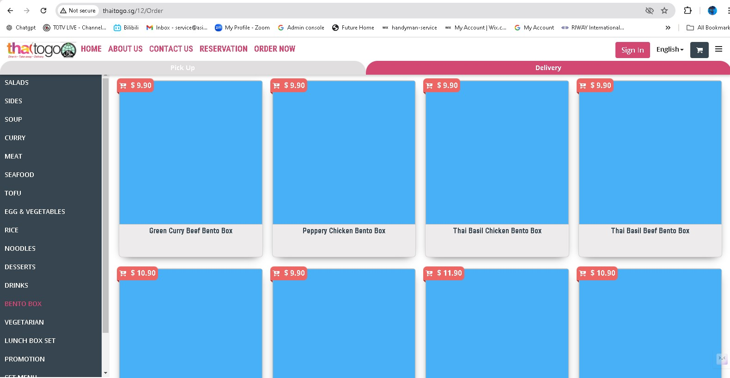
Competitive Analysis – Optimizing Website
Too many missing food images. Customers will assume that the restaurant still under construction
No Image
No Image
No Image
No Image
No Image
No Image
No Image
No Image

Slide 48
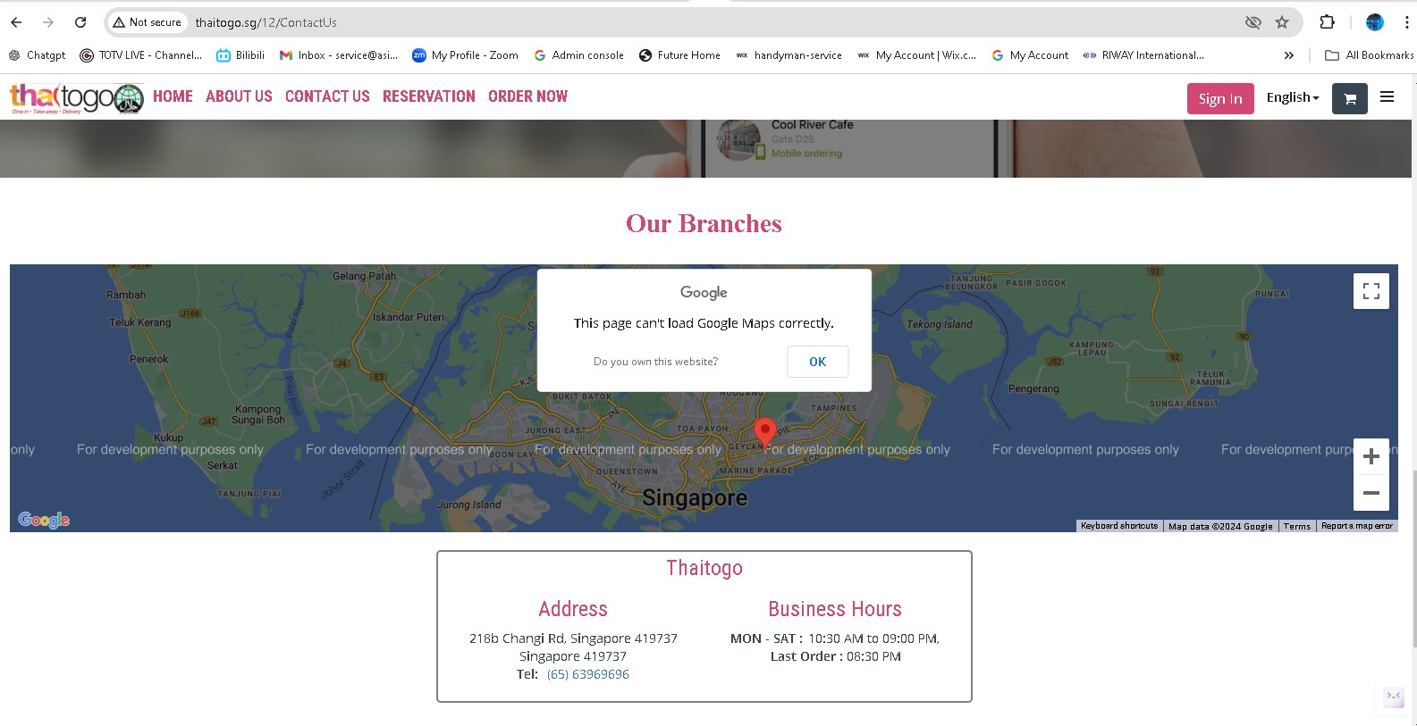
Competitive Analysis - Optimizing Website
Location info still under construction

Slide 49
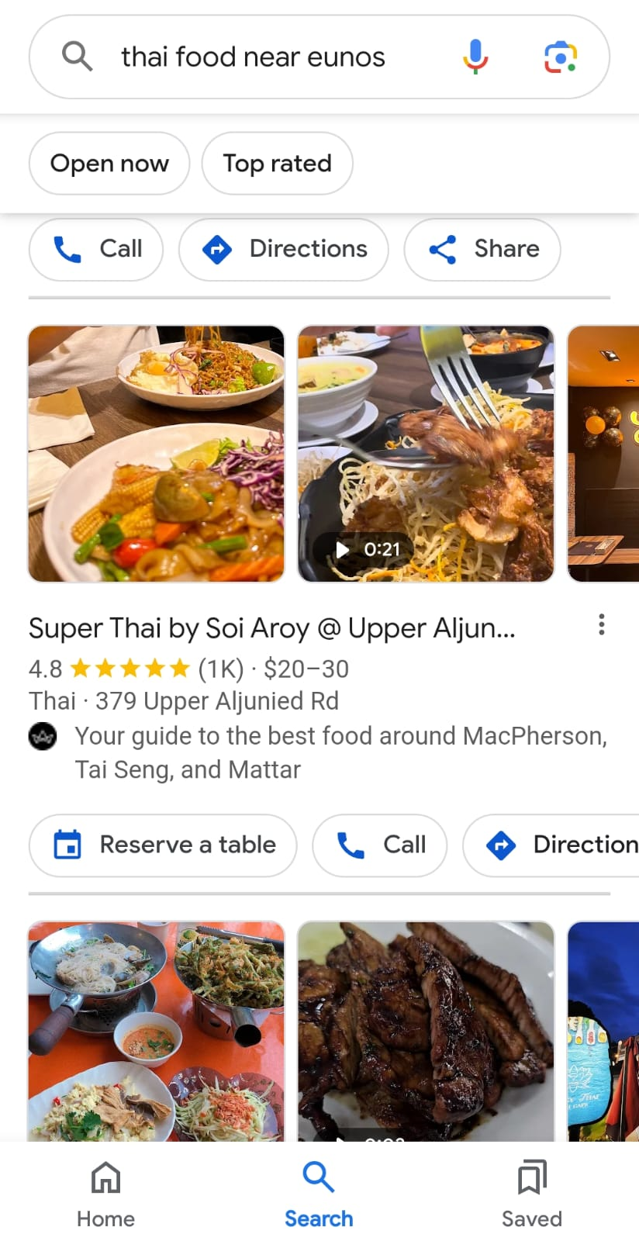
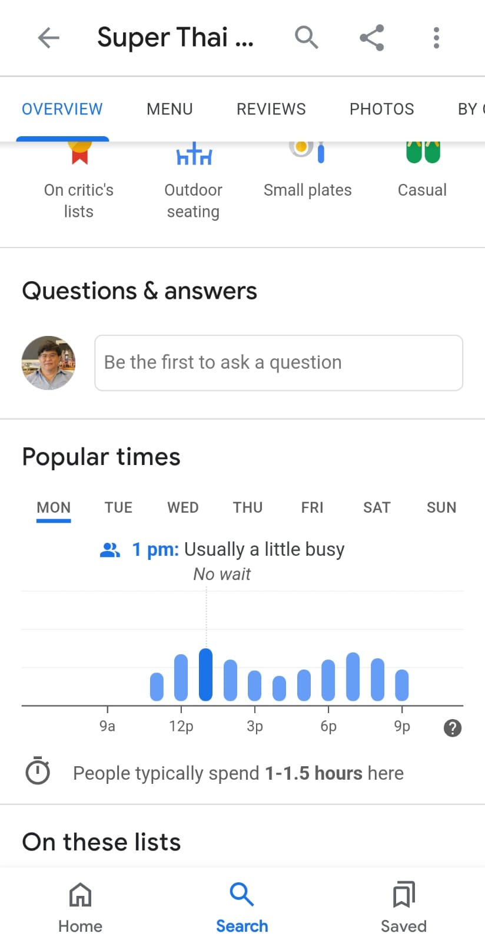
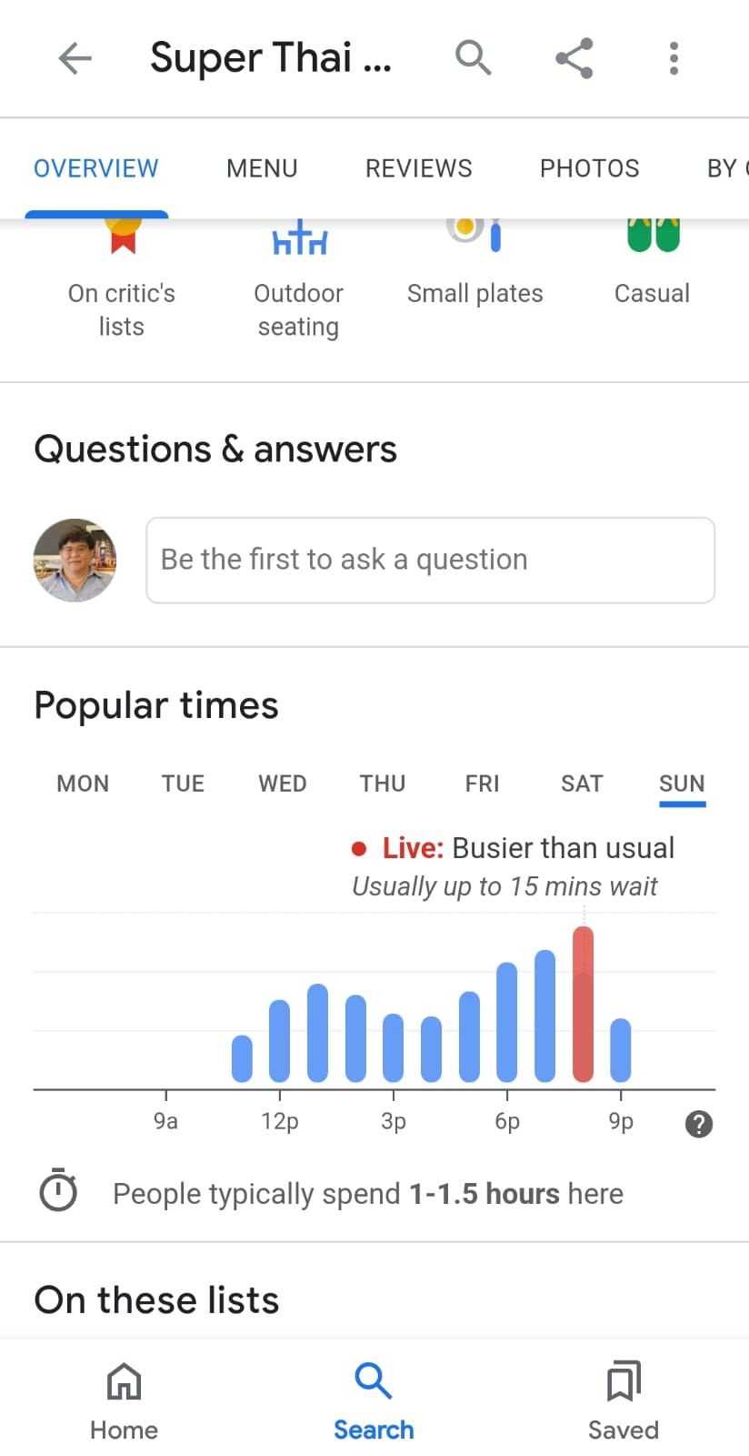
Competitive Analysis - Optimizing Website
Keywords “Thai Food Near Eunos”
Enhance Mobile-phone to be friendly user for customer by:-
Adding “Reserve a Table” Button mobile search.
Adding “Popular Times” info in the mobile search.

Slide 50
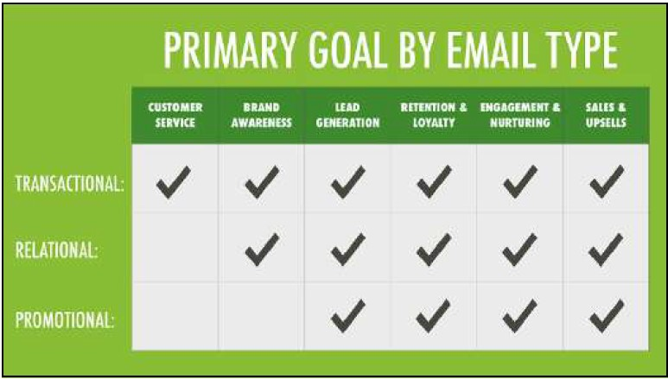
Competitive Analysis - Email Marketing

Slide 51
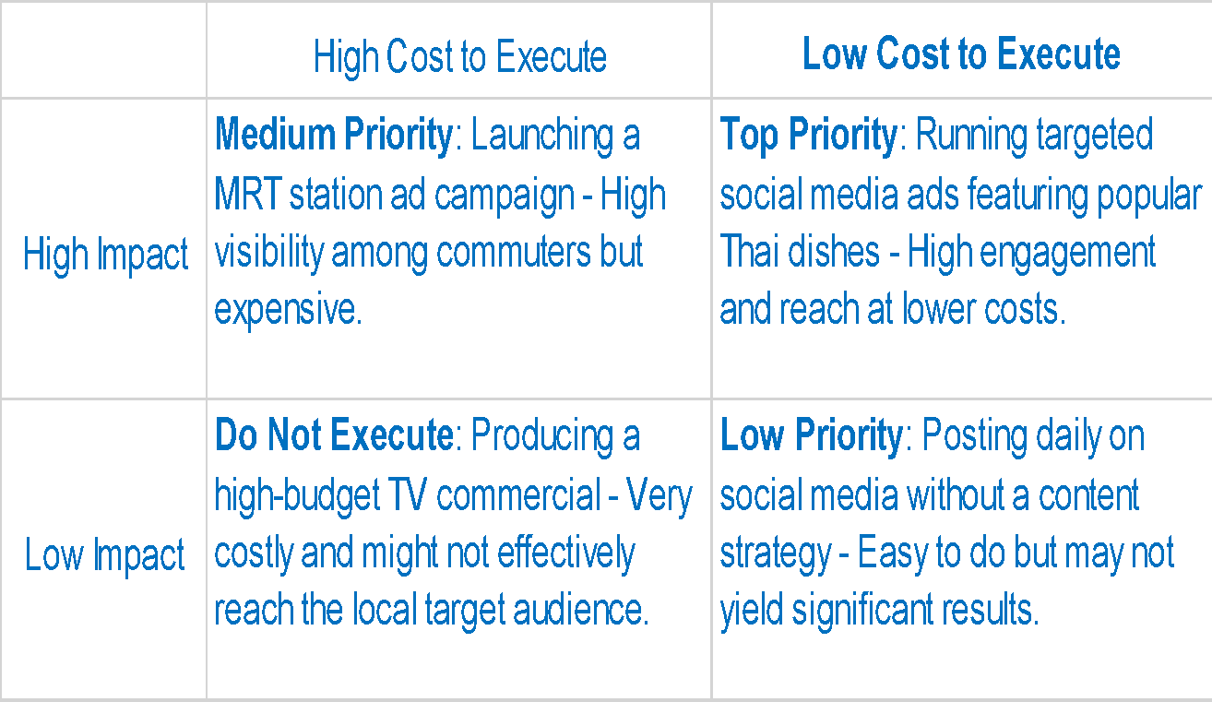
Marketing Prioritization

Slide 52
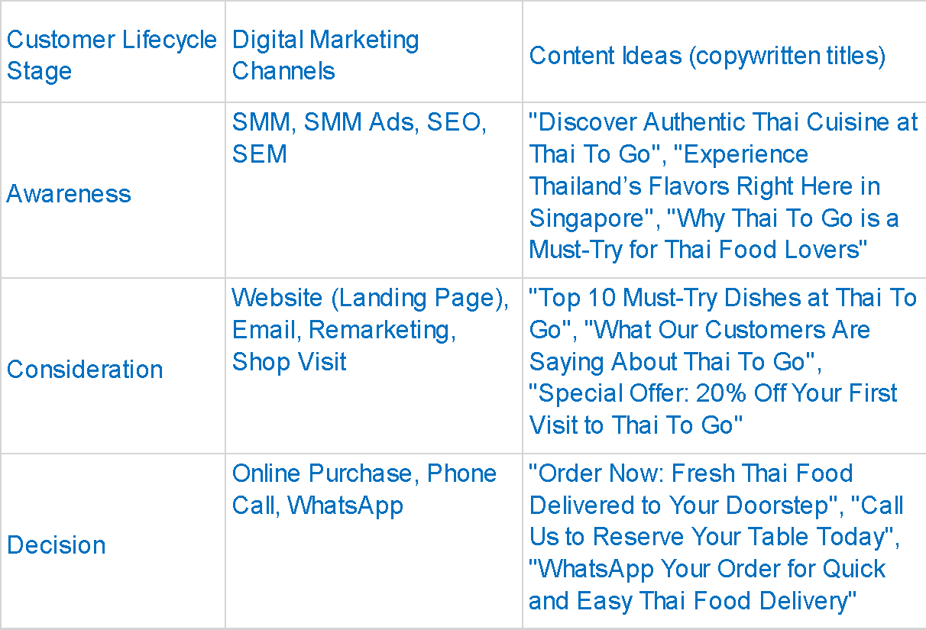
Customer Journey (Content)

Slide 53
Marketing Funnel
Attention
01
Social Media (Facebook, Instagram), Google Ads, SEO
Interest
02
Email Marketing, Retargeting Ads, Website Content
Desire
03
Social Media (Instagram Stories, Facebook Events), Influencer Partnerships, Email Marketing
04
Action
Website, WhatsApp, Phone Calls

Slide 54
Marketing Funnel
Marketing Funnel
Attention
Channels:
Social Media (Facebook, Instagram)
Google Ads
SEO
Content:
Social Media Posts: "Discover the Authentic Taste of Thailand at Thai To Go!"
Google Ads: "Best Thai Food in Singapore - Order Now!"
SEO: Blog posts with keywords like "Authentic Thai Food in Singapore" or "Best Thai Restaurant"
Interest
Channels:
Email Marketing
Retargeting Ads
Website Content
Content:
Email Campaigns: "Sign up for Our Newsletter and Get 10% Off Your First Order!"
Retargeting Ads: "You loved our Pad Thai! Come back for more."
Website Content: Detailed descriptions and high-quality images of popular dishes, customer testimonials, and reviews.

Slide 55
Marketing Funnel
Marketing Funnel
3. Desire
Channels:
Social Media (Instagram Stories, Facebook Events)
Influencer Partnerships
Email Marketing
Content:
Instagram Stories: "Watch our chef prepare our signature Green Curry!"
Facebook Events: "Join our Thai Cooking Workshop this Saturday!"
Influencer Partnerships: Local food influencers sharing their dining experience at Thai To Go.
Email Marketing: "Exclusive Offer: 10% Off for Our Loyal Customers!"
4. Action
Channels:
Website
WhatsApp
Phone Calls
Content:
Website: "Order Online Now for Fast Delivery!"
WhatsApp: "Place your order via WhatsApp for a quick and easy experience."
Phone Calls: "Call us to make a reservation or place a takeout order."

Slide 56
SMART Goals
Channel | Metric | KPI | Duration | Notes (if any)
Landing Page | Conversion rate | +15% | in 3 months time | Optimize the landing page with compelling content and a clear call to action (CTA)
Website | Online orders | +20% | in 3 months time | Improve user experience on the website, making it easier for customers to place orders. Promote online ordering through social media and email campaigns.
Social Media (Facebook) | Number of followers | +25% | in 3 months time | Focus on engaging posts and Facebook Ads targeting food lovers. Share content like customer testimonials, behind-the-scenes, and promotions.
Instagram | Engagement rate (likes, comments, shares) | +10% | in 3 months time | Utilize high-quality images and Instagram Stories. Engage with followers through interactive content like polls and Q&A sessions.

Slide 57
Marketing Execution

Slide 58
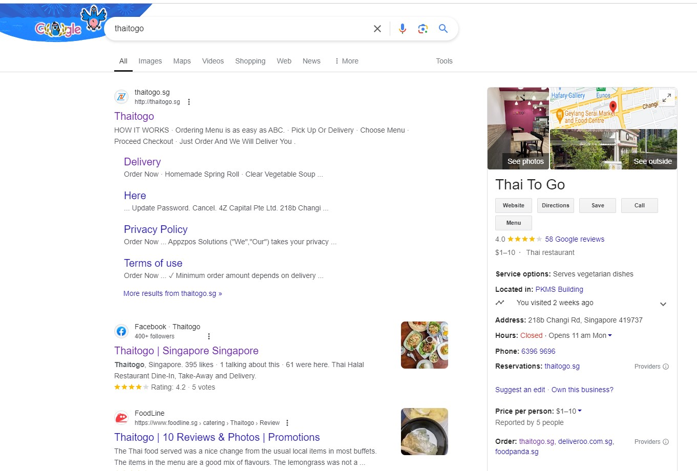
SEM - Google Search Ads

Slide 59
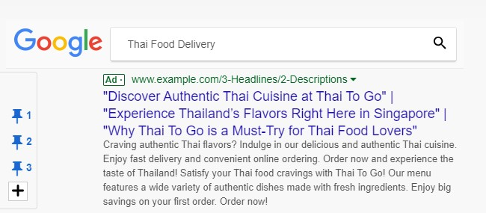
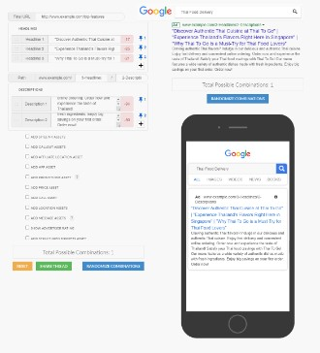
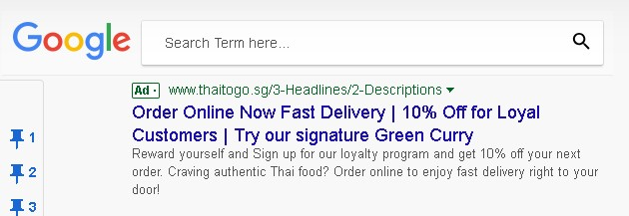
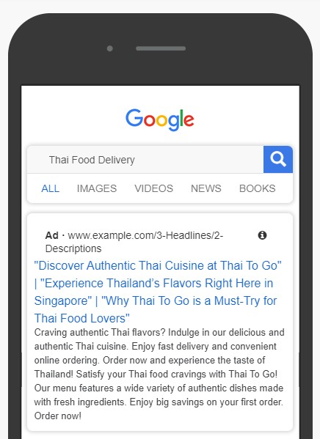
SEM - Google Search Ads (Ad mockups)

Slide 60
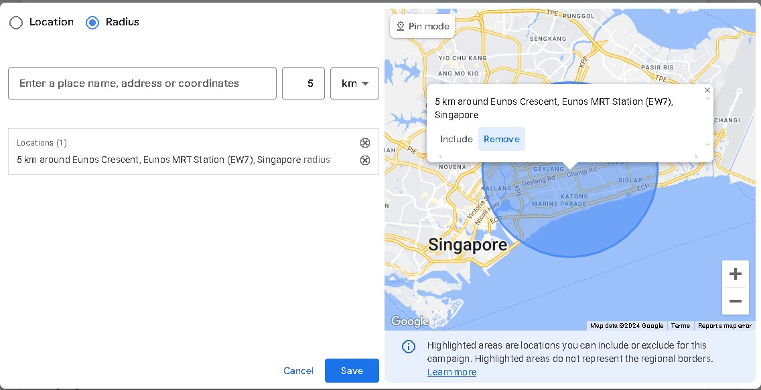
SEM - Google Search Ads (Target Audience)

Slide 61
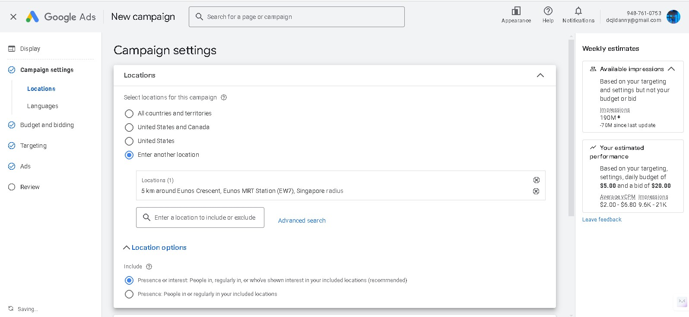
SEM - Google Search Ads (Target Audience)

Slide 62
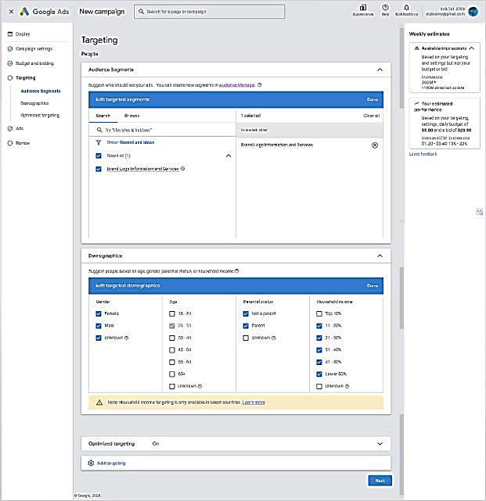
SEM - Google Search Ads (Target Audience)

Slide 63
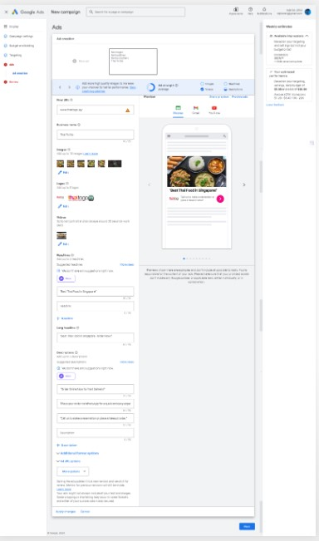

SEM - Google Search Ads (Target Audience)

Slide 64

SEM - Google Search Ads (Target Audience)

Slide 65

Search Engine Marketing (Google Display Network Ads)

Slide 66


Social Media Marketing (Ad) Instagram
Desktop
Mobile Phone

Slide 67


Social Media Posts (Ads) Face book
Desktop
Mobile Phone

Slide 68
Landing Page Desktop
When it comes to the best landing page for Thai food delivery, several options stand out. GrabFood, a popular food delivery platform in Southeast Asia, boasts an impressive landing page that showcases a wide variety of Thai cuisine options. Another top contender is Foodpanda, which offers a user-friendly interface and a robust selection of Thai restaurants. For a more boutique experience, consider Deliveroo, which features a curated list of high-end Thai eateries. Each of these landing pages offers a seamless ordering experience, ensuring you can indulge in your favorite Thai dishes with minimal hassle.

Slide 69

Landing Page Desktop
Desktop

Slide 70

Landing Page Desktop
Desktop

Slide 71

Landing Page Desktop
Desktop

Slide 72

Landing Page Desktop
Desktop

Slide 73

Landing Page Mobile Phone
Mobile
‹#›

Slide 74

Landing Page Mobile Phone
Mobile

Slide 75
Email Marketing
# | Content of email | Call To Action in Email
1 | Welcome to Thaitogo! Enjoy $5 off your first order. Introduce Thaitogo, highlight unique selling points (e.g., authentic Thai flavors, fast delivery), and provide an exclusive discount code. | Explore Our Menu, Sign Up for Newsletter
2 | Craving something spicy? Try our new Red Curry! Showcase a specific dish, include mouth watering images, and provide a brief description of the ingredients and flavors. | Order Now, Learn More
3 | Our customers love us! Read what they say. Share positive customer reviews and testimonials to build trust and credibility. | Read More Reviews, Share Your Experience
4 | Don't miss out! Enjoy 20% off your next order. Create a sense of urgency with a limited-time discount offer, highlight popular dishes, and include a clear call to action. | Order Now, Redeem Offer
5 | Become a Thaitogo VIP and enjoy exclusive rewards. Introduce a loyalty program with benefits like discounts, free delivery, or exclusive menu items. | Join Now, Learn More

Slide 76

Email Marketing

Slide 77

Email Marketing

Slide 78

Email Marketing

Slide 79

Email Marketing

Slide 80

Email Marketing

Slide 81

Video Marketing

Slide 82
**Monitoring and Adjusting Strategy**
"We'll closely monitor key performance metrics such as online orders, website traffic, and conversion rates using Google Analytics. This data will guide any necessary adjustments to our strategy, ensuring we stay on track to achieve our goal."

Slide 83
**Projected Outcomes**
"By implementing these strategies, we project a 10% increase in online delivery orders, resulting in a significant ROI boost. This growth will not only improve our bottom line but also strengthen ThaiToGo's brand presence in Singapore’s competitive food delivery market."

Slide 84


